Slide 1
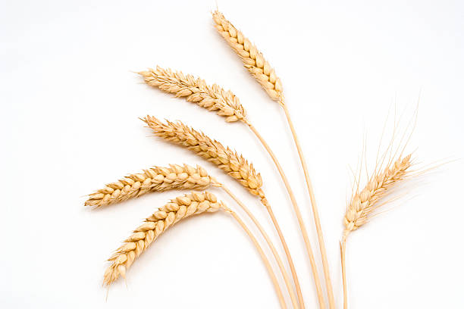
Day 1: Five Stalks of Grain and the Ukrainian Holodomor

Slide 2
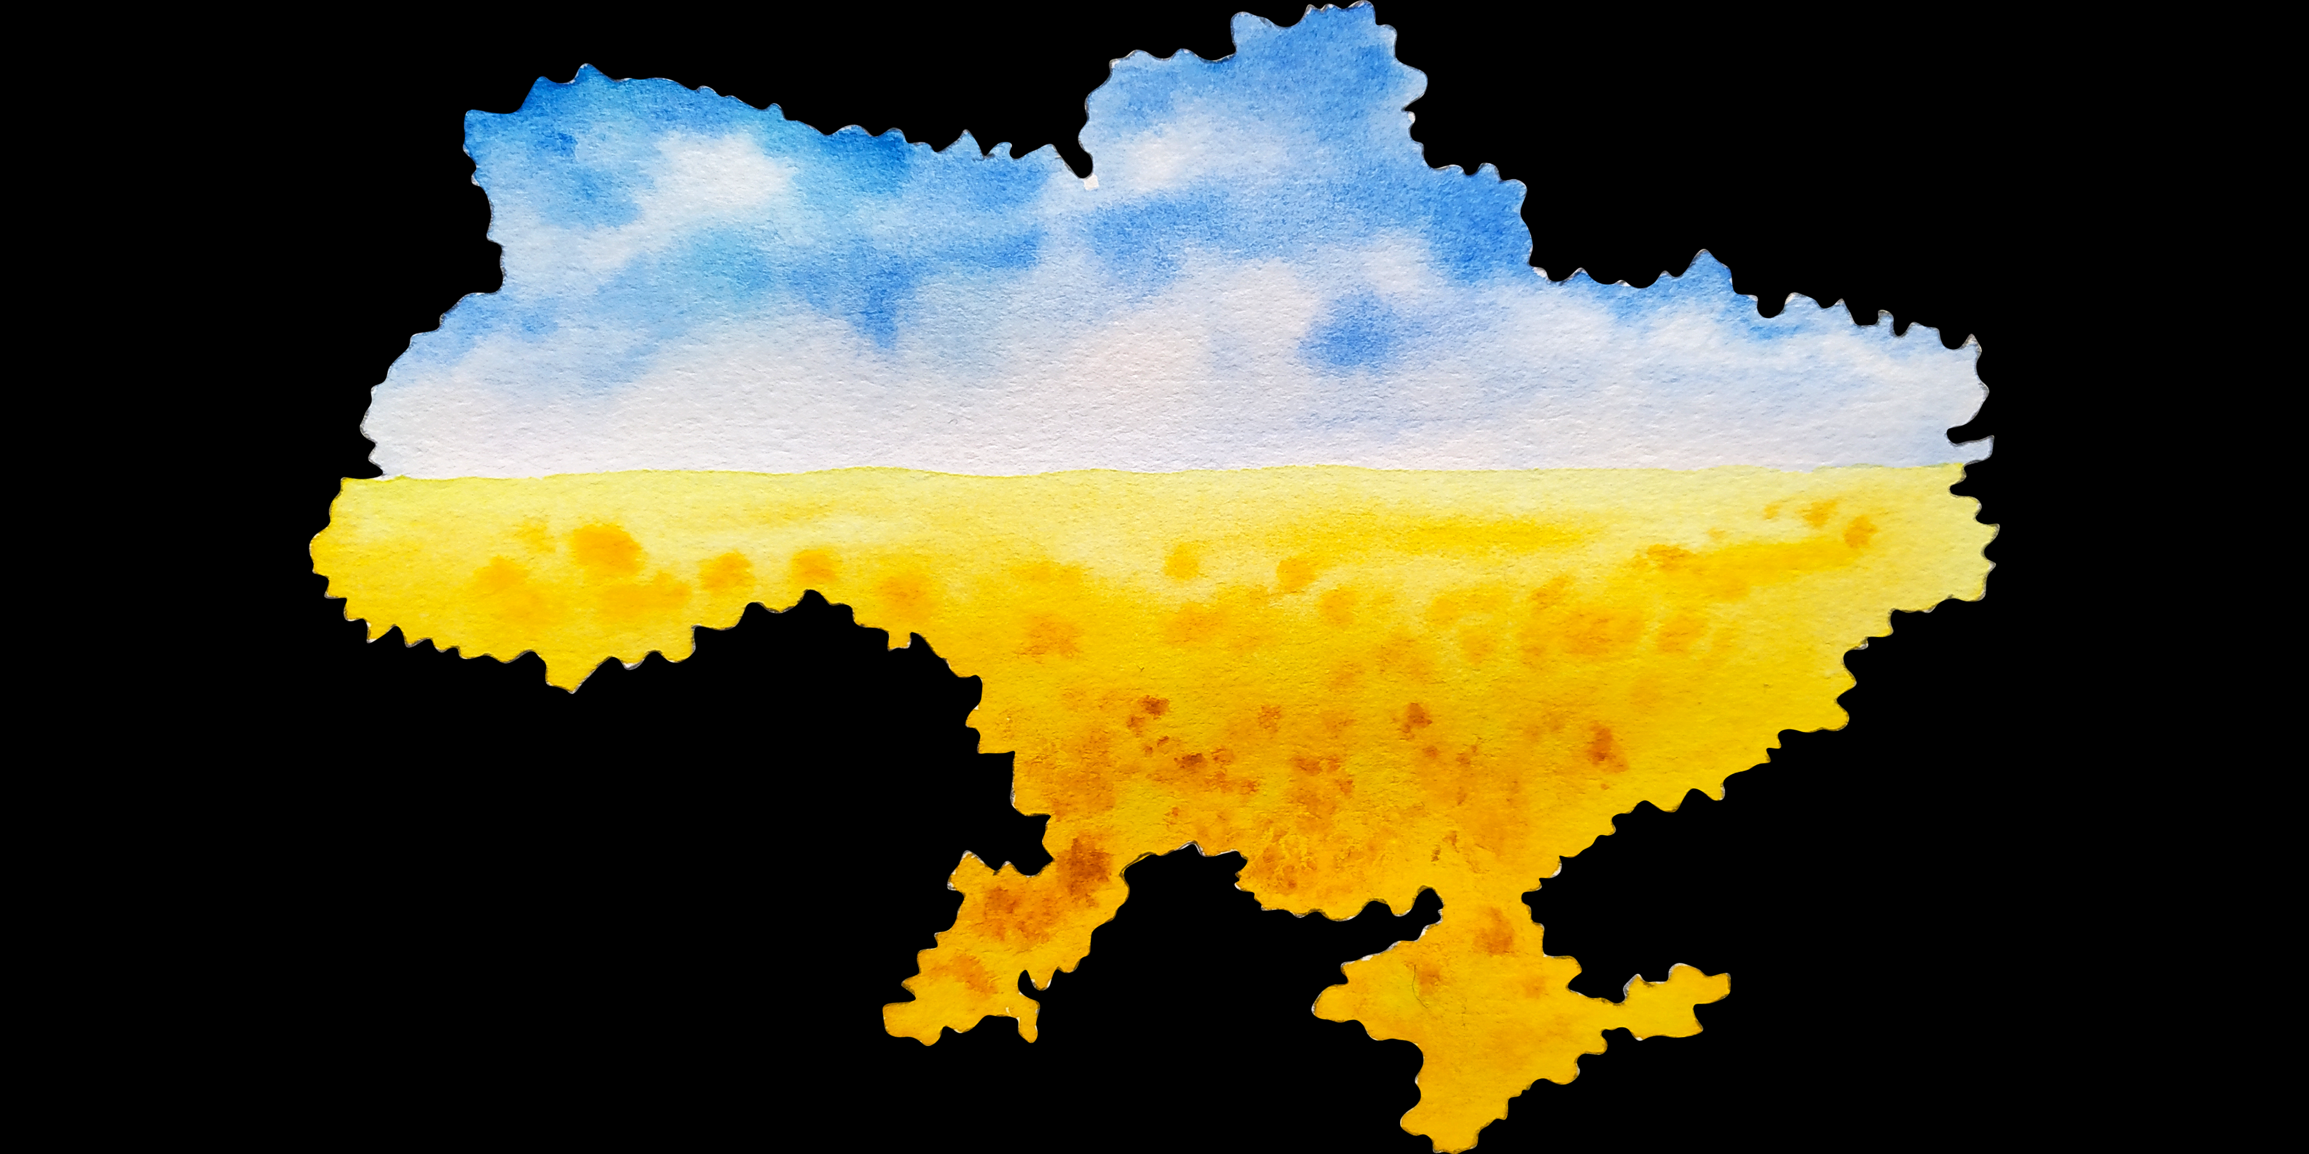
What do you know about Ukraine?

Slide 3
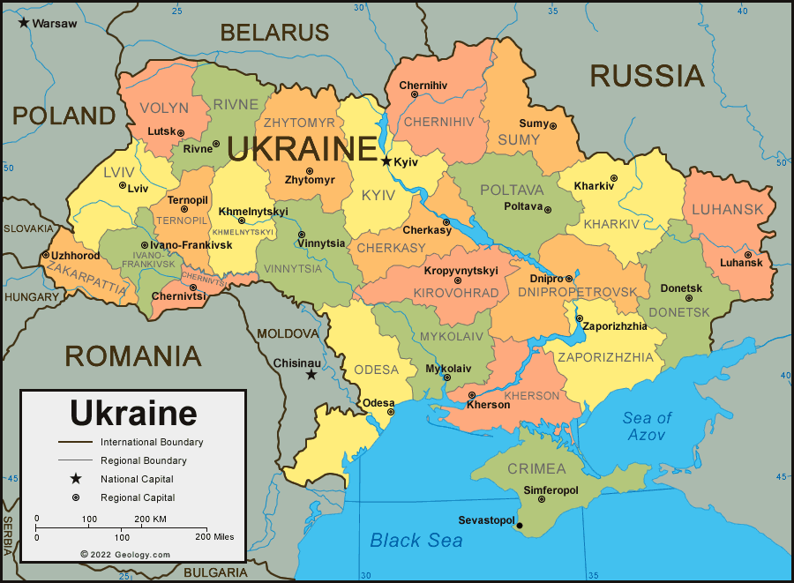
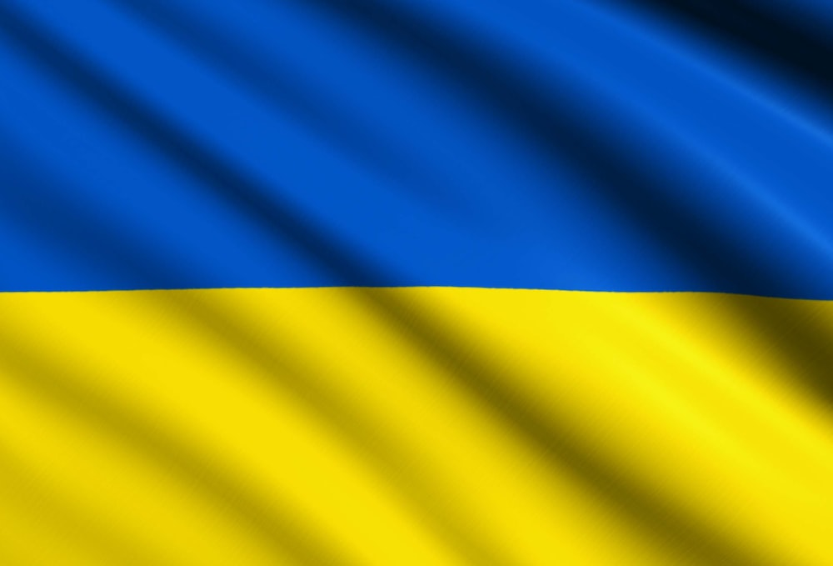
Ukraine
Capital: Kyiv
Currency: Hryvnia
Area: 233,090 sq. miles
Population: 38,000,000
Language: Ukrainian
Religion: 87% Christian
Notes:
Ukraine is the second largest country in Europe after Russia and the 45th largest country in the world.
The population (2022) number is from the World Bank

Slide 4
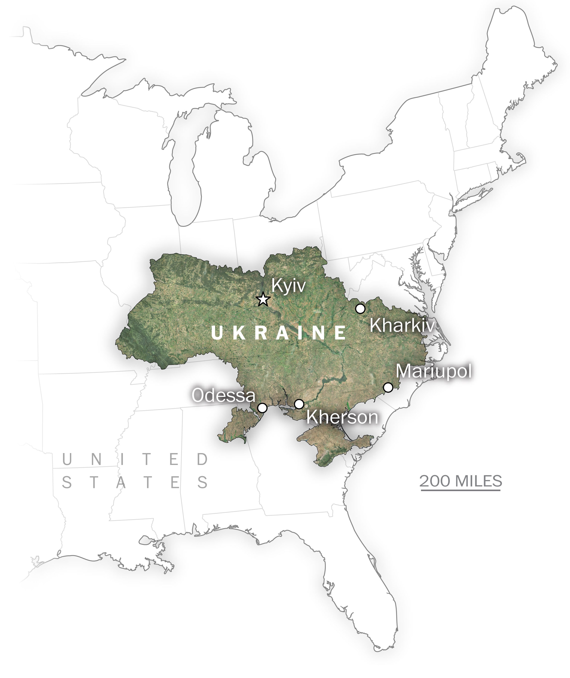
Ukraine compared to the USA by size
Notes:
To give students a sense of Ukraine’s size, show them how large it is in comparison to the USA. Ukraine’s area is 233,090 sq. miles and the US is 3.797 million sq. miles.
Image source: Washington Post

Slide 5
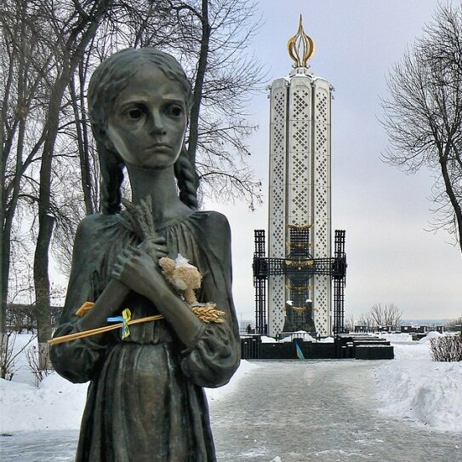
The Holodomor
голод [holod] starvation
Морити [moriti] to exterminate
Notes:
The word Holodomor is derived from the Ukrainian word for starvation, holod, and the word for exterminate moriti
The photo is of the commemoration statue known as Bitter Memory of Childhood which is located in Kyiv. It’s part of a larger complex and museum that commemorates the Holodomor. It was established in 2008, on the 75th anniversary of the Holodomor.

Slide 7
Number of Victims of the Holodomor
On the most fertile land in Europe at the height of the famine in 1933 Ukrainian villagers were dying at rate of:
17 per minute, 1,000 per hour, 25,000 per day
3,000,000 victims were children
5 – 10 million victims based on journalist accounts
Current estimate based on reliable data of Holodomor victims 4.6 - 5 million
Harvard Ukrainian Research Institute: Geographic Information Systems Atlas of the Holodomor
Institute of Demography in Kyiv: detailed demographic data at the district level from 1930s

Slide 8
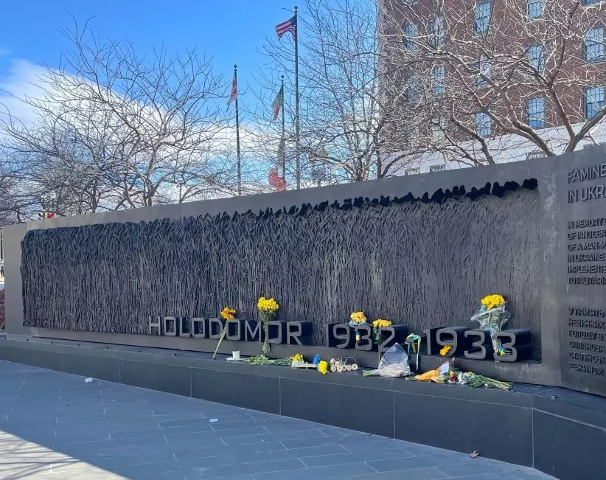
How can food be used as a weapon?
Notes:
This is the Holodomor memorial in Washington D.C.
Here you can discuss some images in the novel in connection to this question. On page 64 you can discuss the image of the barefoot starving man, who no longer looks human, begging for food, while a man in a suit walks by. You can discuss pages 99 and 100 that show the grain taken from rural Ukrainians and sent to the cities and abroad. Page 34 shows people dying or dead in the street. This is an accurate depiction of the Holodomor. You can show historical photos from the Holodomor at this link https://education.holodomor.ca/educational-resources-list/photo-gallery/historical-photographs-of-the-holodomor-2/
More info on the Holodomor memorial in DC:
HONORS: The 7 to 10 million victims of the Ukrainian famine of 1932-33 DATE DEDICATED: November 7, 2015 SCULPTOR: Larysa Kurylas MEDIUM: Bronze sculpture on granite plinth

Slide 9
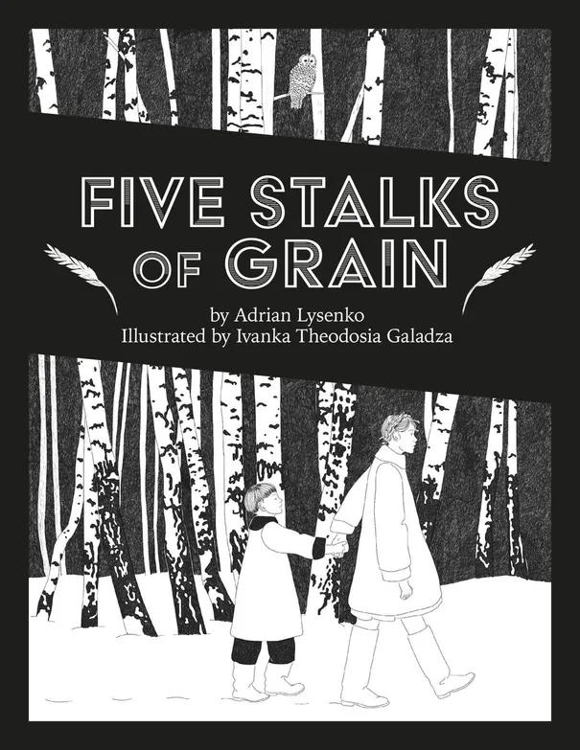
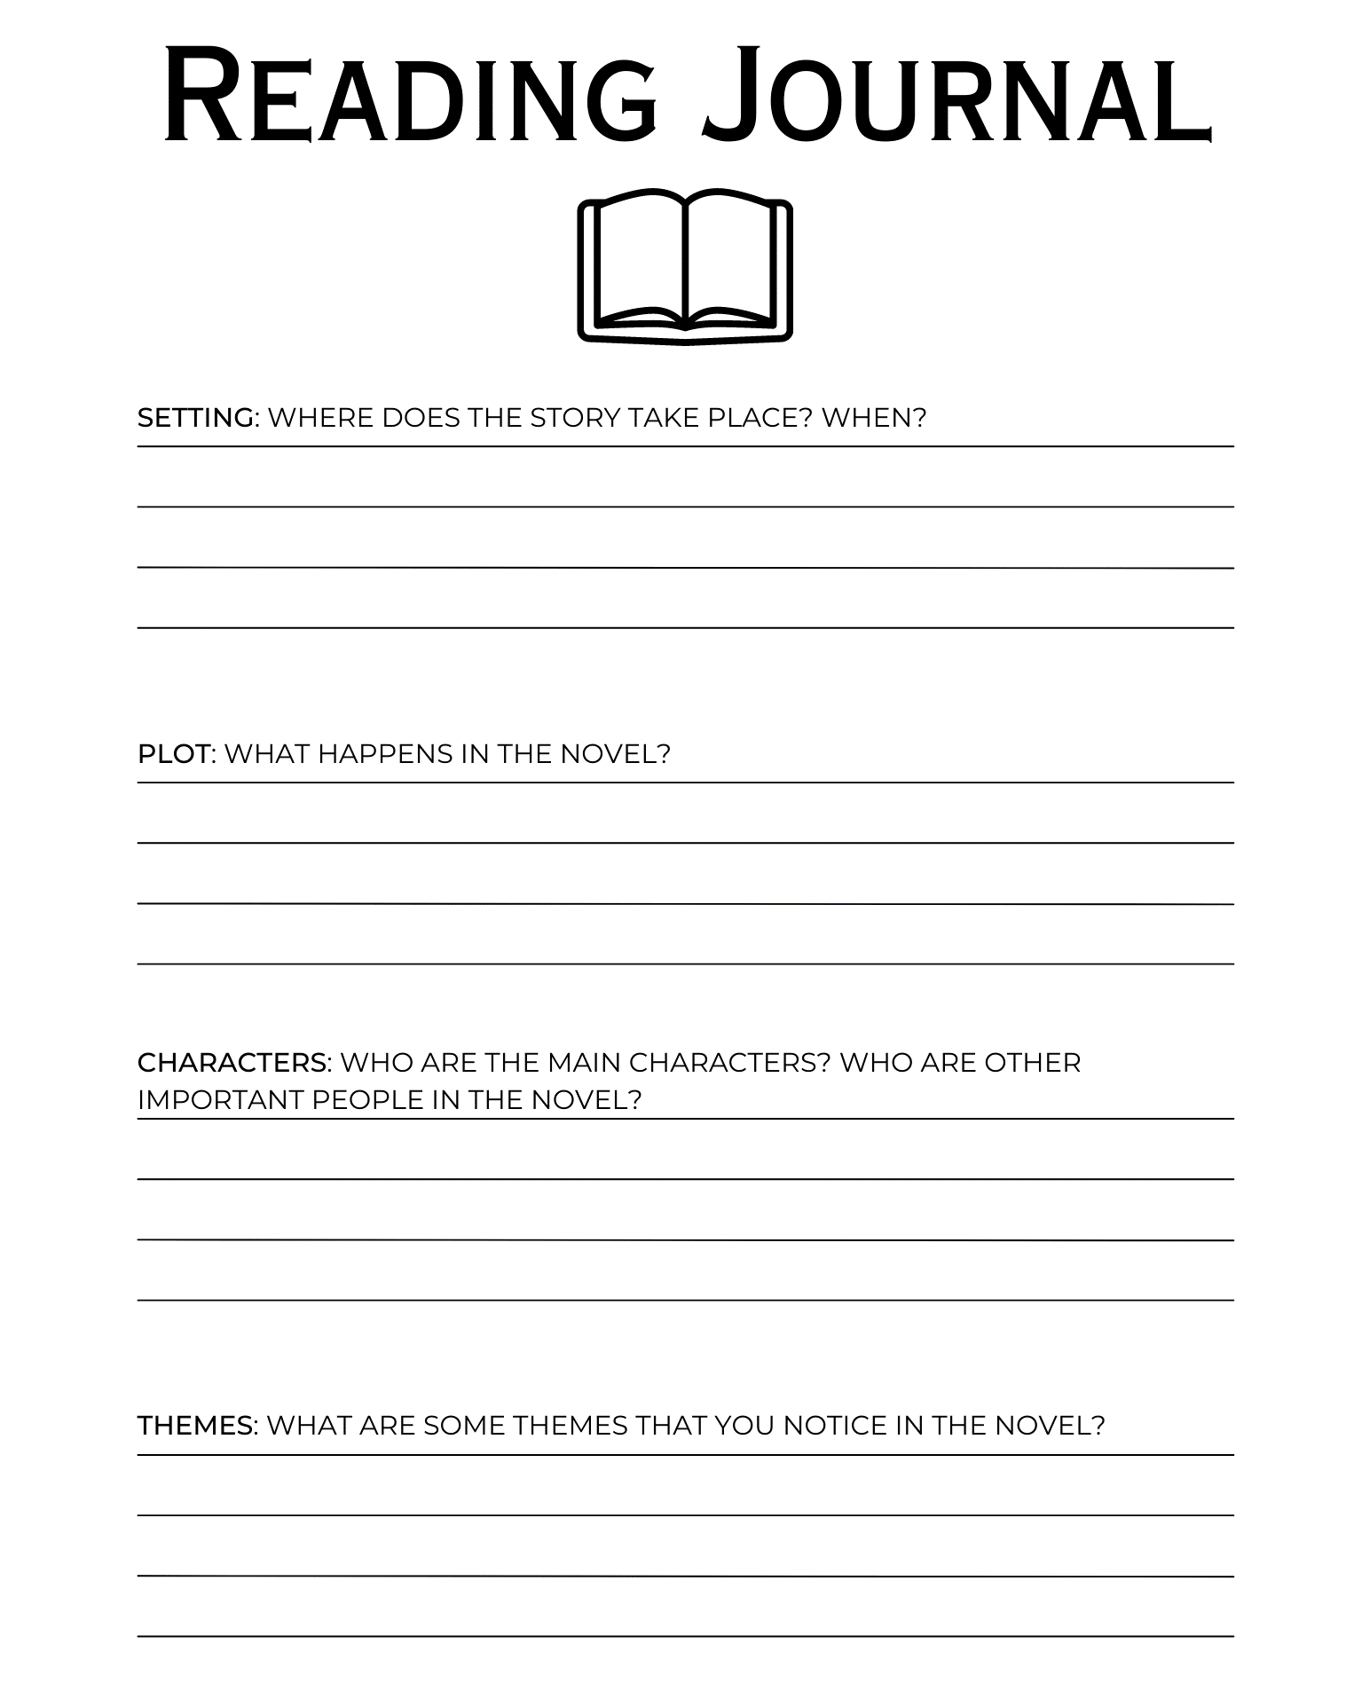
Homework

Slide 10
Day 2: Five Stalks of Grain and the Ukrainian Holodomor

Slide 11
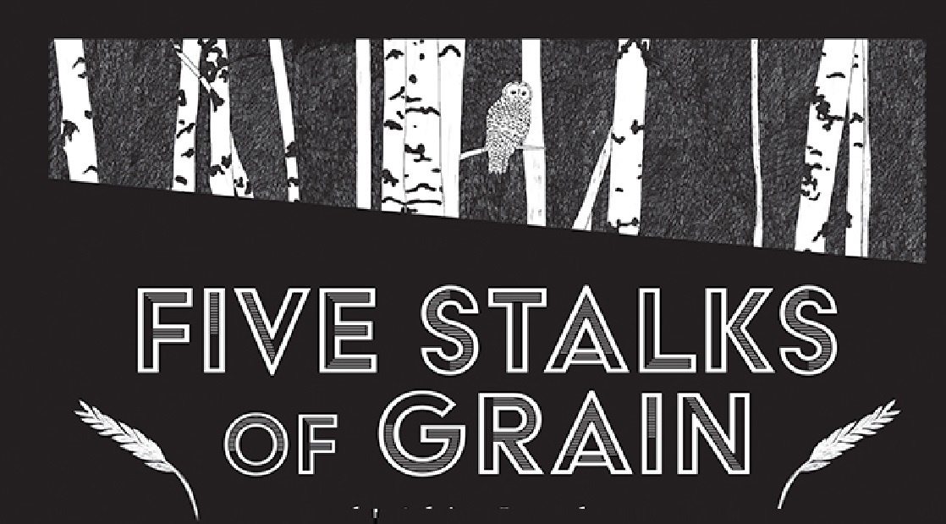
Why do you think the novel is called Five Stalks of Grain. Would you have called it something else? Why or why not?

Slide 12
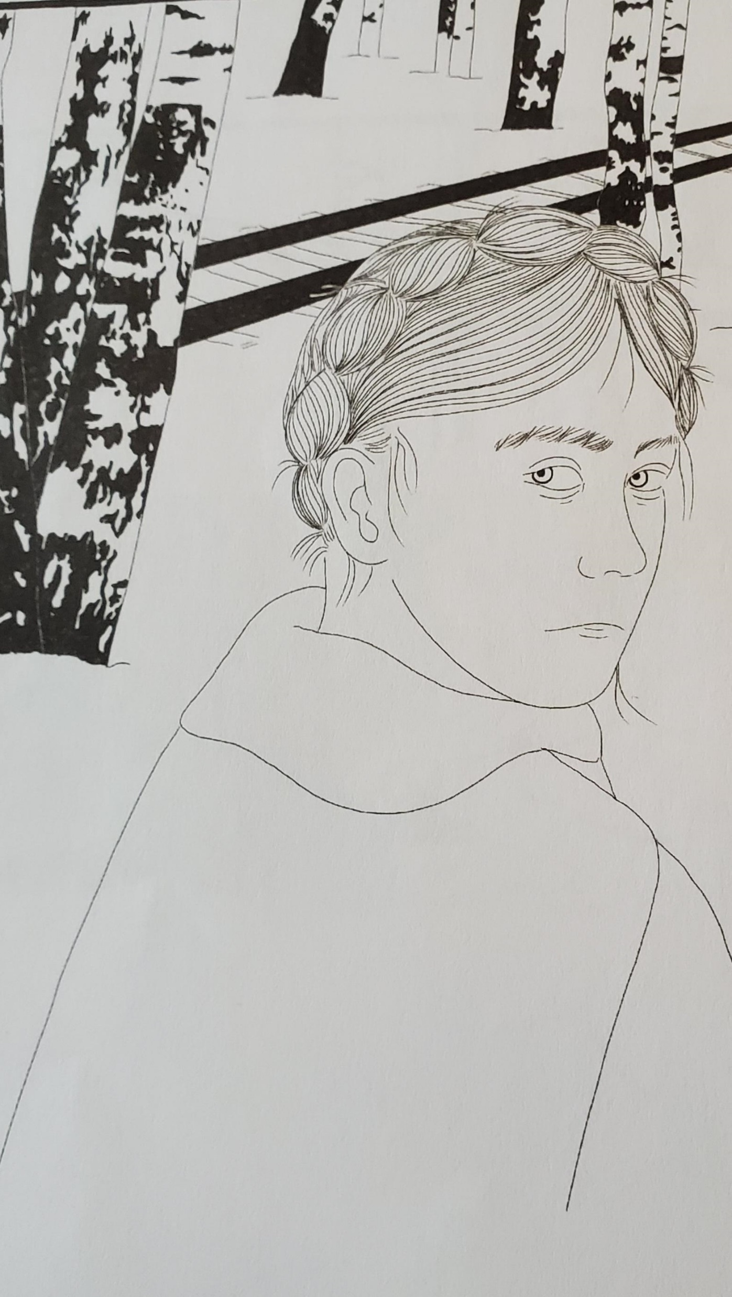
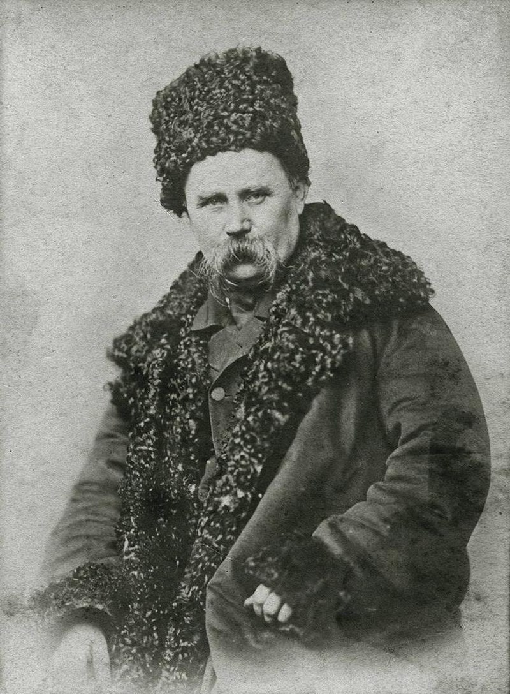
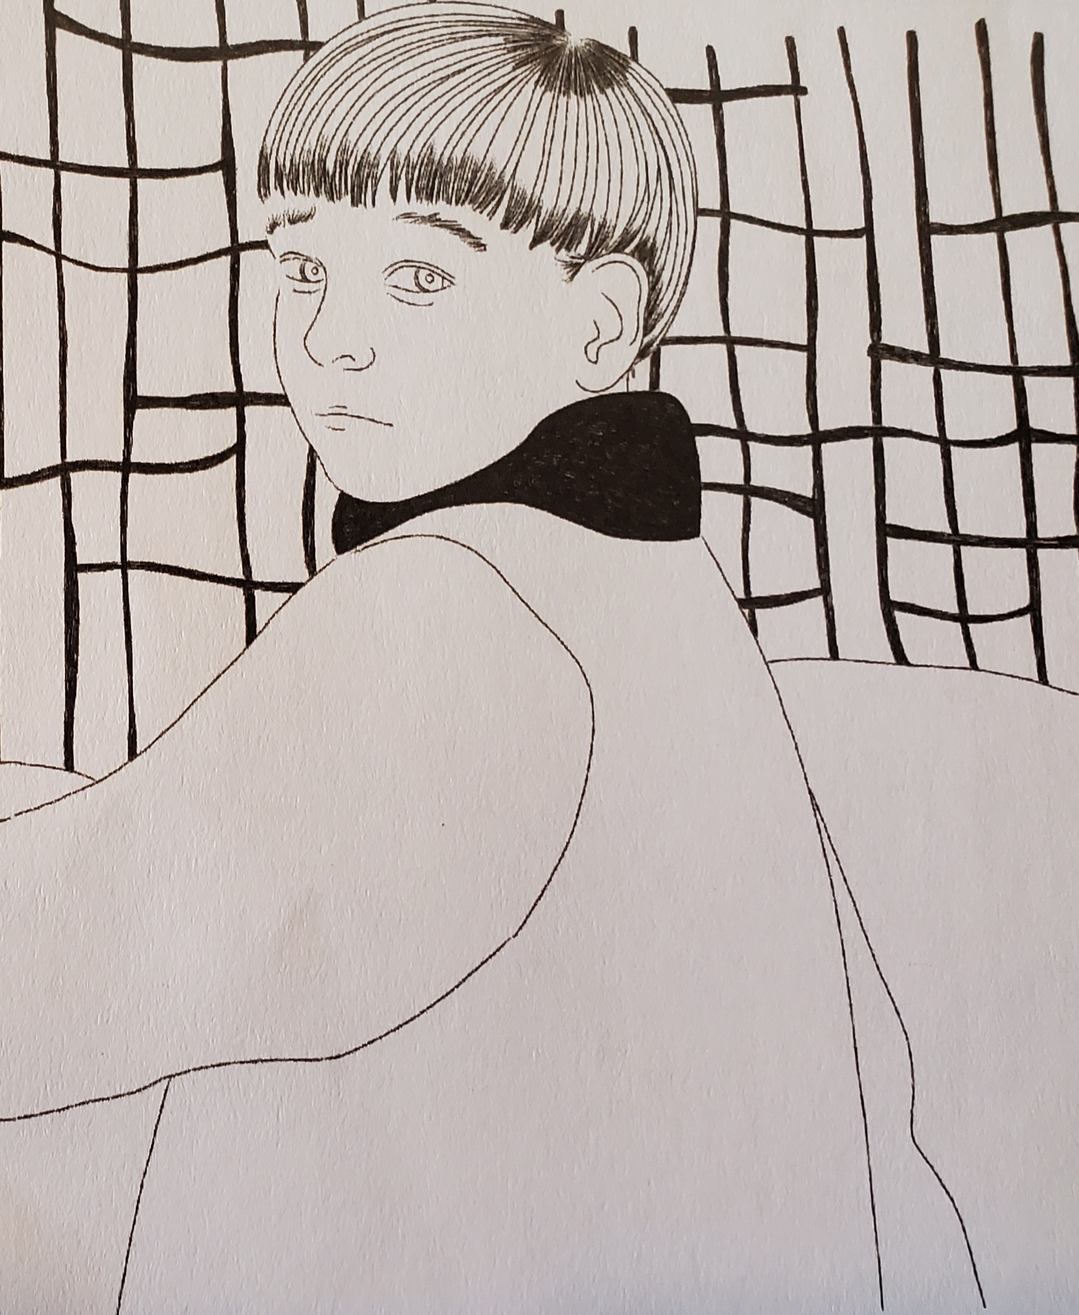
Who are the main characters?
Nadia
Taras
Notes:
Ask the students who the main characters are? See if they remember the names. Tell them about the meaning behind the characters’ names.
Nadia comes from the Ukrainian word надія [nahDEEya] which means hope. Why do they think the author would give her this name? One of the novel’s themes is hope in the face of adversity. Nadia is the one who survives until the end. Hope prevails.
Taras is a boy’s name that became popular in Ukraine since it is associated with Taras Shevchenko (1814-1861), a national poet and unifying figure for the Ukrainian nation. Naming your son after Shevchenko came to signify allegiance to the national cause. Why would the author give the boy this name?
Taras is eventually taken by the Soviet authorities who say they are taking him to an orphanage in the city. We don’t ever find out what happens to Taras. He could be a symbol of the Ukrainian national heritage which was under attack by the Soviets. Nadia motivates Taras and protects him. Perhaps this is the author’s way of telling his fellow Ukrainians that hope is instrumental to keeping their heritage alive. Are there other interpretations that you or the students have?

Slide 13
What happens in the novel?
Nadia and Taras’ father is arrested (for refusing to join kolkhoz)
Their mother is killed in front of them while they are hidden (accused of hoarding grain)
Nadia and Taras set out to find food/means of survival
To escape the OPGU and because he promised food, they follow a man into the woods, he tries to attack them
Nadia fights back, OPGU officer kills the man, saving the kids, gives them bread, and tells them to go to the city
Nadia tells Taras how their father received the Order of the Red Banner medal
Young Pioneer finds them in the city and calls them Enemies of the People. Nadia and Taras run away
Taras gets caught in a fence and is left behind, leaving Nadia alone
She follows an owl to an old woman’s house. Old woman feeds her and tells her about Toll Houses
Old woman bribes a guard to take Nadia to the city
They stop at a warehouse and Nadia sees all the grain stored for sale abroad/in the cities
Counter revolutionaries kill the men who are transporting Nadia
They don’t trust her, then want her to kill the OPGU man, she refuses
One counter revolutionary says he will take her to Taras, but takes her to a pile of bones, saying he has died
She leaves, following the train tracks, sees a bird and gives it some grain, she walks down the tracks and the bird flies off toward the sun.
61 years later Nadia’s descendants visit her home and find her story
Notes:
Instead of just retelling the plot, you could give each student a piece of paper with an event from the novel on it. They will have to get up and arrange themselves in order of what happens and then read their event aloud down the line, thus retelling the plot. Getting them out of their seats is a nice way to reset their attention.

Slide 14
What are the main themes of the novel?
Notes:
What themes did you and your students notice? Some themes to consider are survival (both physical survival and the survival of a story/idea), hope and perseverance in the face of extreme adversity, family, trauma, inherited/generational trauma, family history and identity, transformation, the soul’s journey, morality (people aren’t just good or evil), and bravery.

Slide 15
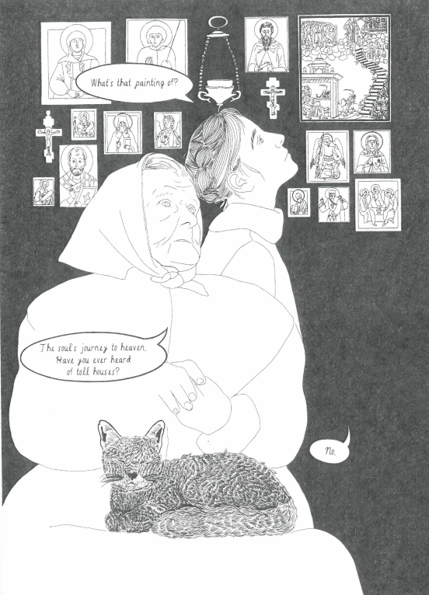
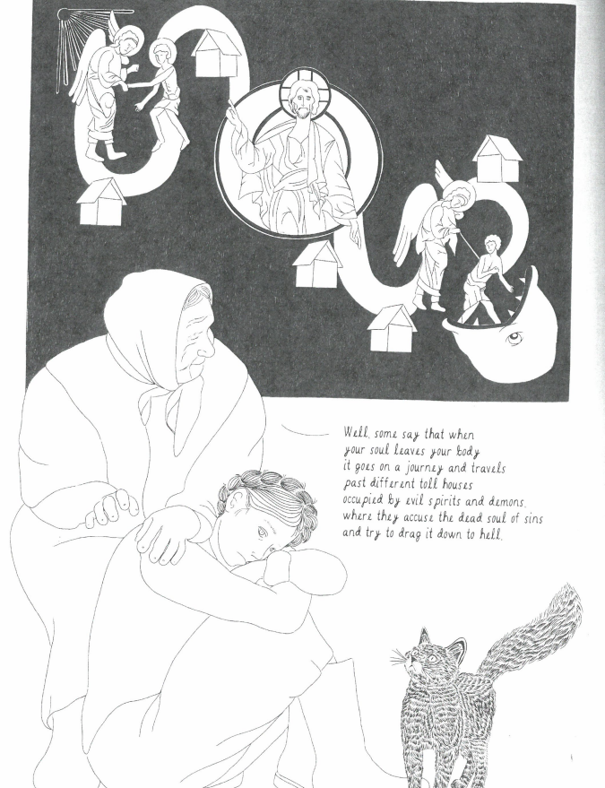
Toll Houses and the Soul’s Journey
Notes:
Nadia is looking at the various icons in the old woman’s house and sees one that interests her in particular. She asks what it is and the woman says, the soul’s journey to heaven. She asks Nadia if she has ever heard of toll houses.
In an interview, the novel’s illustrator, Ivanka Galazda, said that this particular icon was her inspiration for an initial sketch she made when she first started working on the novel. It is the 19th century Orthodox icon called the Death of St. Theodosia, which depicts her soul traveling through the afterlife.
The old woman mentions toll houses. Some Orthodox people believe that after a person dies, angels escort their soul to heaven. On this journey, the soul passes through a realm inhabited by evil spirits. The soul encounters these demons, which accuse the soul of sins and try to drag it down to hell. The points of these encounters are called toll houses. There are several toll houses, the number of them is not exact. These are where the soul is tested on its way to heaven. The first toll-house is where the soul is questioned about sins of the tongue (lies/slander). The following toll-houses include things like gluttony and laziness, theft and covetousness, injustice, envy and pride, anger, murder, magic, lust, adultery and sodomy, heresy, and lack of mercy ( source: orthodoxinfo.com/death/theodora.aspx).
The author and illustrator said that the idea of toll-houses is the underlying theme of the novel. Nadia goes on a journey and is tested along the way until her soul, represented as a bird, eventually ascends to heaven. St. Theodosia is the patron saint of the infirm.

Slide 16
What “toll houses” do Nadia and Taras encounter on their journey?
Notes:
Another way of asking this is, how were Nadia and Taras tested on their journey? What difficult situations did they face and how did they handle them? Were there some cases where they were tested morally?
One test is the man who tries to kill them in the woods. Nadia’s courage is tested. She is brave and defends her brother. On page 41 the top panel shows her pushing her brother away from the danger, putting him physically in front of her.
Taras is hungry and asks Nadia for more bread. Instead of giving in to her body’s temptation to eat more, she rations the bread because they will need it later. This is another way she protects her brother, as well as herself.
When the officers chase Nadia and Taras, Taras gets stuck in the fence and gets left behind. Nadia chooses to keep running instead of go back for her brother.
When the counter revolutionaries shoot the men taking Nadia to the city (hidden in the grain trailer) Nadia gives up her hiding spot and asks them not to kill the man. The counter revolutionary explains that this man takes people to the camps or kills them and Nadia said this happened to her parents. When the counter revolutionary offers her to gun saying she should shoot the man it is an opportunity for her to give in to vengeance, hatred, anger, and violence. However, she refuses and asks them to show the man mercy. When they kill him she calls them demons.
When the man takes Nadia to the pile of bones, telling her her brother is dead, she could give up and go with them. Instead she holds onto her hope that she will find her brother and continues toward the city.
Pages 132 and 133 show what could be interpreted as her soul arriving to heaven. She didn’t give up hope and held true to her morals. She was not tempted by sins like violence or revenge.

Slide 17
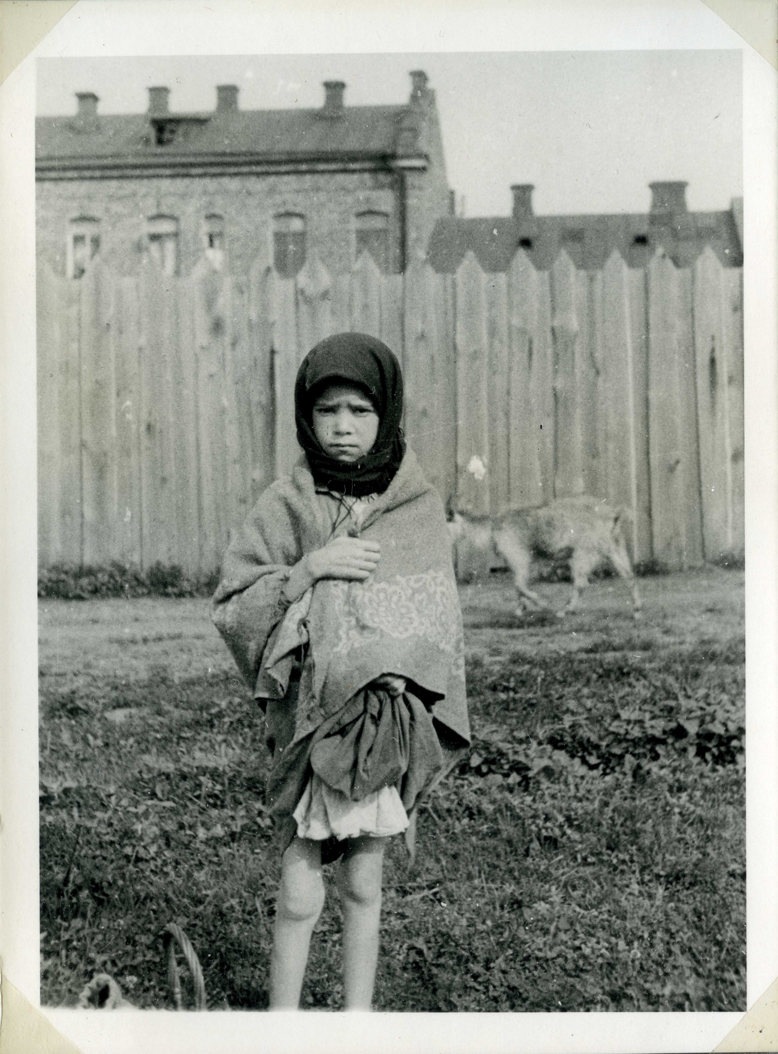
What health issues (physical and mental) arose as a result of the Holodomor?
Notes:
Photo from 1933 titled “Worker’s Daughter in Kharkiv” by Alexander Wienerberger.
You can see that the girl has very skinny legs. The fact that there’s a goat in the background shows that her family was lucky because they had a supply of milk and maybe even meat. Most people were not so fortunate.

Slide 18
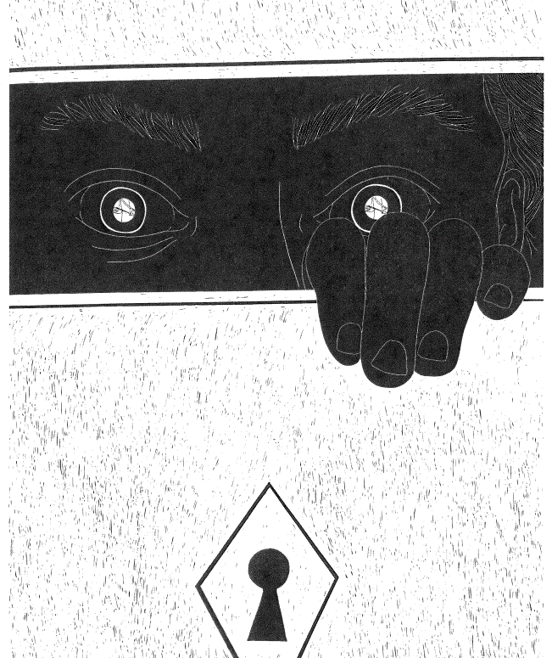
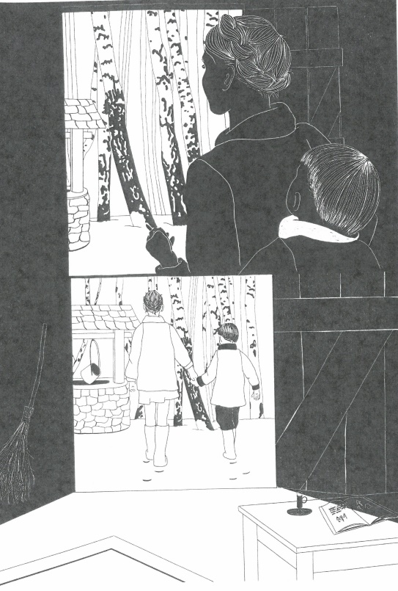
Trauma and Transformation

Slide 19
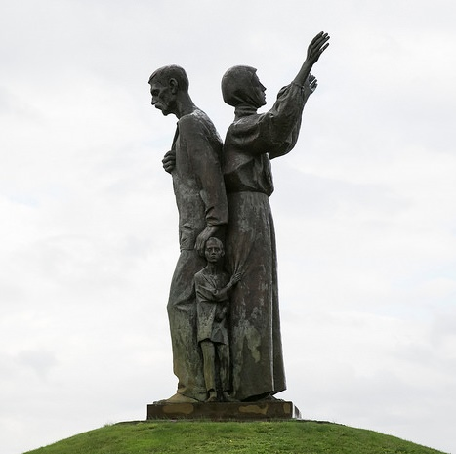
Generational Trauma
Notes:
Photo is the Kharkiv Holodomor memorial.
Definition of trauma/generational trauma from health.com
Trauma is a response to a devastating event, resulting in adverse physical and emotional outcomes. Traumatic events may include abuse, discrimination, natural disasters, racism, and war.
Generational trauma is trauma that extends from one generation to the next. It begins when a group experiences a traumatic event that causes economic, cultural, and familial distress. In response, people belonging to that group develop physical or psychological symptoms.
People who experience trauma may develop health conditions like:
Anxiety
Depression
Heart disease
Post-traumatic stress disorder (PTSD)
Then, subsequent generations may inherit trauma and those health conditions through factors like discrimination and prejudice.
Some studies have found the following regarding generational trauma and the Holodomor. Quotes are from Viktoriia Gorbunova and Vitalii Klymchuk, “The Psychological Consequences of the Holodomor in Ukraine,” EWJUS 7.2, 2020.
“Behavioural features of Holodomor descendants include irrational stockpiling/hoarding of excessive food supplies, an inability to discard unwanted and unneeded items, an extreme reverence for food, overeating, and a permanent state of anxiety regarding survival.”
“Holodomor descendants have a national inferiority complex (for example, they compare their personal abilities unfavourably with the abilities of Russians), a permanent fear of defeat, and low levels of aspiration”
“There is evidence among Holodomor descendants to suggest the existence of a Stockholm syndrome (a psychological alliance with the captors during captivity) between the Ukrainian people and the aggressor, which results in a deformation of worldview, the creation of a Soviet values system originating from a fear of using the Ukrainian language, and an impulse to appear loyal to any type of national identity”

Slide 20
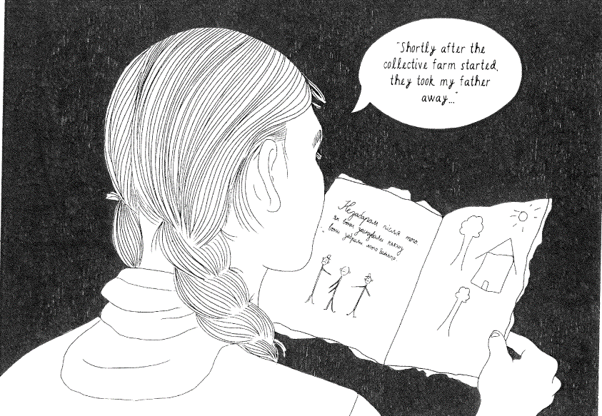
Why is it important that Nadia’s family visits her house in Ukraine 61 years later and reads her story?
Are there parts of your family history that inform your identity?
Notes:
You can tell them that 61 years later would have been 1993-1994 which was after the collapse of the Soviet Union (1991). After the collapse, Ukraine declared independence and became its own country.
Why is it important that Nadia’s family (and people generations later) know the stories of their families? How does an event like this shape a nation’s identity?
If you want you can share some clips of Holodomor survivors’ children http://www.ucrdc.org/Archive-Oral-History-Children_of_Holodomor_Survivors_Speak.html
If you want you can even discuss how the event could shape Ukraine’s feelings about Russia as a motivation during the ongoing war.

Slide 21
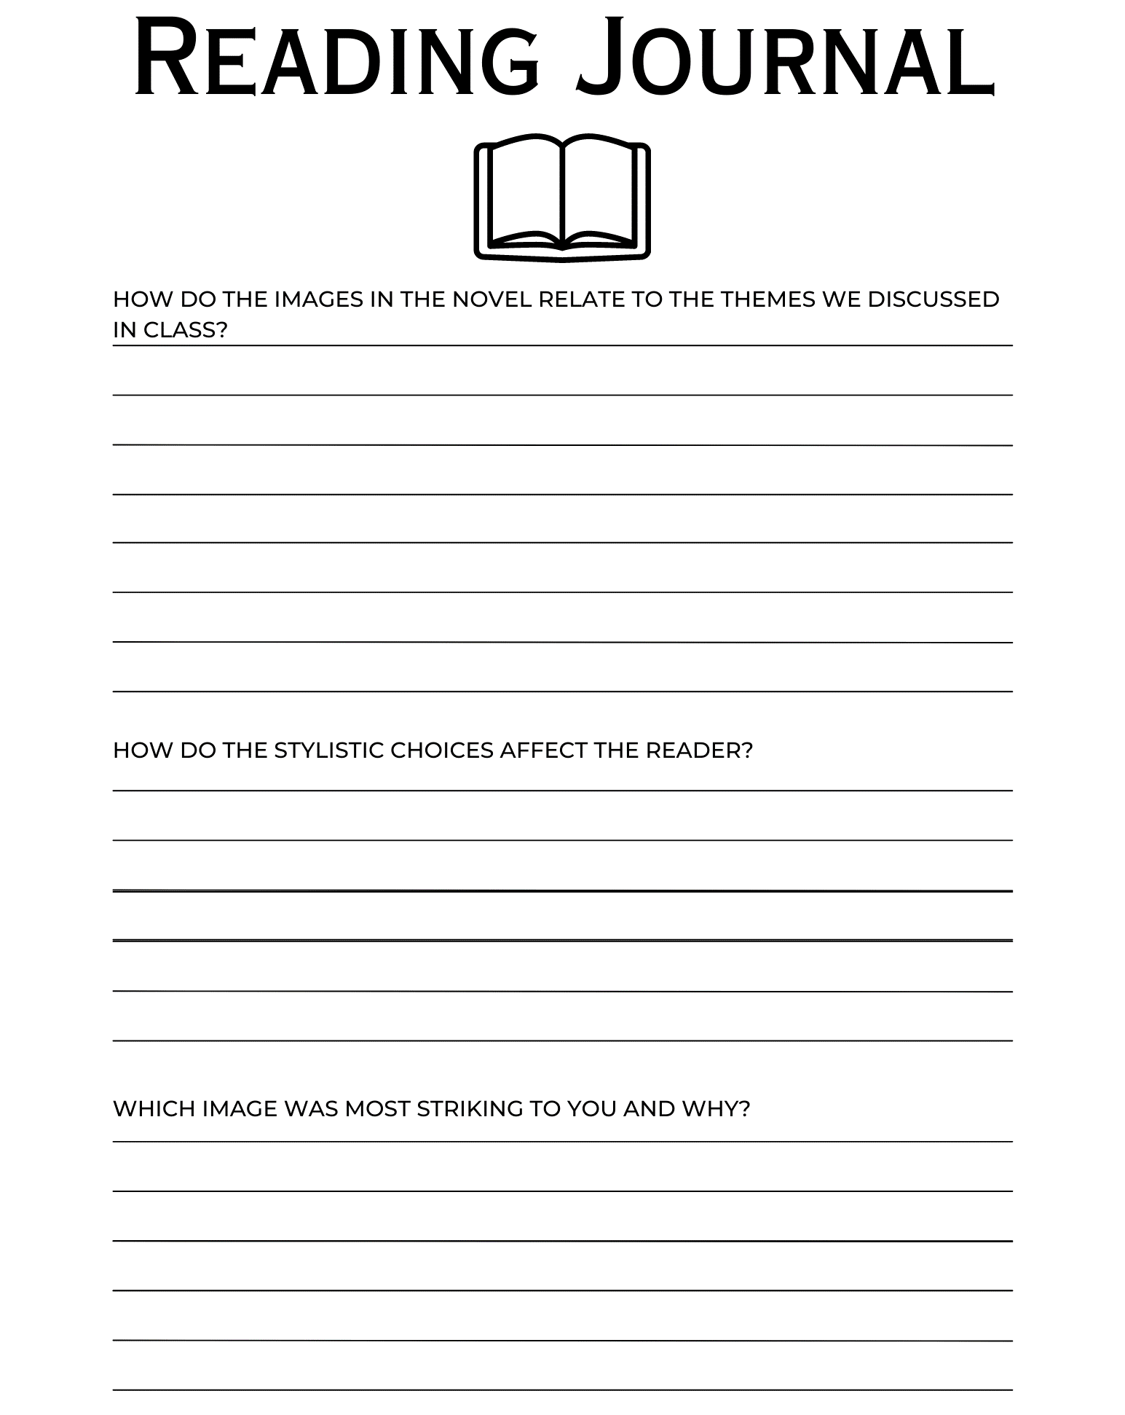
Homework

Slide 22
Day 3: Five Stalks of Grain and the Ukrainian Holodomor

Slide 23
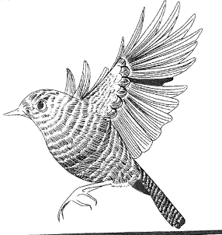
How are the themes presented visually?
How do the stylistic choices affect the reader?
Notes:
Ask your students how the illustrator presents the novel’s themes visually? What does she focus on or repeat? What about the use of contrasting colors?
The illustrator focuses on characters’ eyes and hands a lot. The eyes are windows into the characters’ minds. It is a way to express emotions without words. You can reference page 32 here. The first panels focus on different peoples’ eyes: the empty stare of the man, the intimidating look of the OPGU officer, and Nadia’s fear. The bottom panel shows hands. By adding the closeup of the man’s hand grabbing Nadia’s we get a hint at his desperation. He grips her hand tightly. His nails are long, giving him an animalistic quality that is off-putting. You can also reference page 15 which shows Nadia’s eyes peeking out of the trunk. The OPGU officer’s hands are reflected in here eyes. This is a major point of trauma/transition for Nadia.
The use of black and white calls attention to the theme of transition. The illustrator switches to a black background with white lines to highlight moments of transition.
Page 15-24 The switch to black background here shows the importance and transitory nature of the traumatic events Nadia and Taras experience.
Page 24: Shows Nadia and Taras half black background and half white background. It shows them stepping out of the house, away from the scene of trauma and out into the world in search of means of survival.
Page 33: The man switches from someone who seems to want to help to someone dangerous.
Ask them how the stylistic choices affect the reader? The graphic novel is all in black and white? How did this affect them?
In an interview, the illustrator mentioned that the lack of color keeps the depiction of violence from becoming too graphic. “You’d be lacking that artistic discretion and be veering more into more straight up realism, and that can be sort of off putting.”

Slide 24
Trauma and Transformation

Slide 25
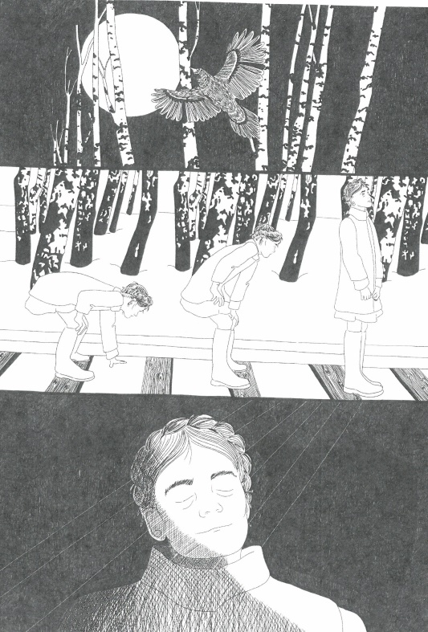
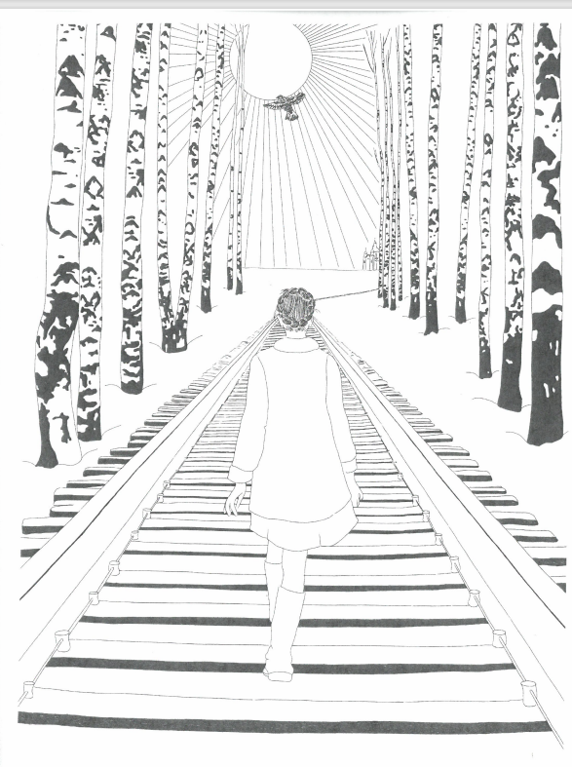
hope and perseverance in the face of adversity
Notes:
You can talk about the theme of hope and perseverance in the face of extreme adversity and the soul’s journey to heaven using these images.

Slide 26
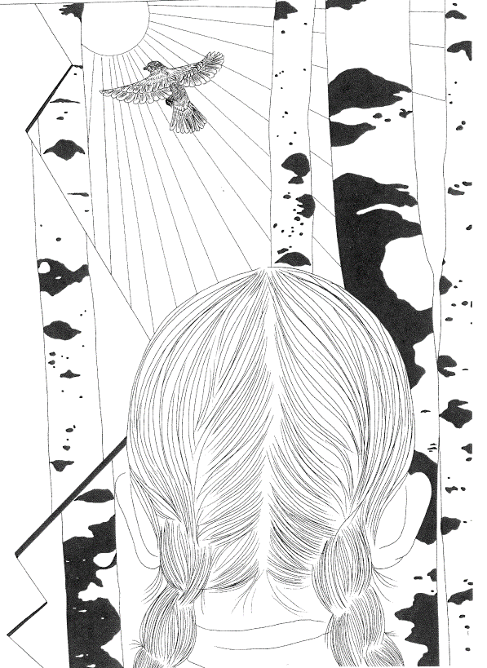
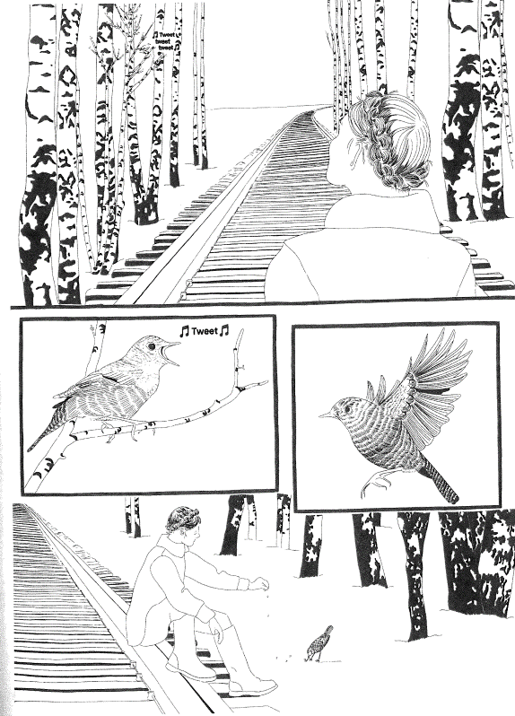
Birds as Symbols
Notes:
You can talk about the repeated image of the bird as a symbol for the soul or memory. Nadia brings up her mother’s memory by talking about the bird calls she taught her and Taras. Nadia feeds a bird before walking down the train tracks. Once Katya learns Nadia’s story, she sees a bird at the house and watches it fly off.

Slide 27
Assignment:
Create your own short graphic novel on a theme from Five Stalks of Grain. Your novel can be based on your life, on something from history, or be completely made up.
To accompany your graphic novel, write a page or two explaining how your novel embodies your theme. What stylistic choices did you make to portray their theme to the reader? Are the characters’ names important to your novel’s meaning? What visual references inspired your novel in terms of the artwork? Why?
Notes:
You can assign them a theme or have them choose their own.
If they don’t want to draw pictures for their project they could find images online or from magazines/newspapers

