Slide 1
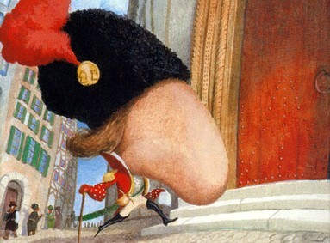
“The Nose”
By Nikolai Gogol

Slide 2
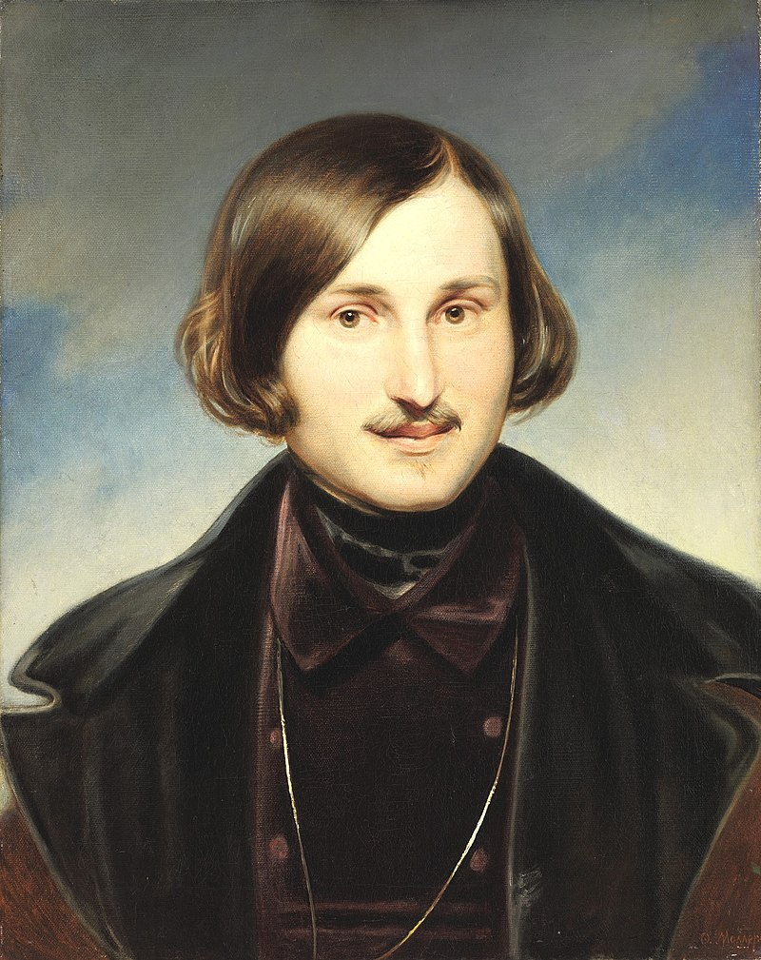
Nikolai Gogol
Born in 1809 in the Ukrainian town Sorochyntsi.
Moved to St. Petersburg in 1828 at age 20
He first was recognized for his series of short story collection Evenings on a Farm Near Dikanka (1831).
Worked in the civil service and then taught at the university but resigned in 1835.
Published several works including a satirical play “The Government Inspector” (1836) and the novel Dead Souls (1841).
Died in 1852
Notes:
Gogol spoke Ukrainian and Russian but wrote his literature in Russian, the language of the Russian Empire.
His first series of short stories was based on his Ukrainian heritage including Ukrainian folklore.
He worked in the civil service as a translator and later taught medieval history at the university, for which he was unqualified. He resigned after a year. His experience with bureaucracy and the pretentious rank-obsessed Petersburg society influenced his later writer, as you will see when you read “The Nose.”
He became increasingly interested in religion and felt it was his calling to save Russia by helping return it to the principles of Christianity and brotherly love.
He tried to write a second part to his novel Dead Souls but burned the manuscript. When his confessor told him to renounce literature and enter a monastery Gogol replied, “Not to write means the same to me as not to live.” He eventually refused to eat for 9 days which led to his death in 1852 at age 42. He never married or had any children.

Slide 3
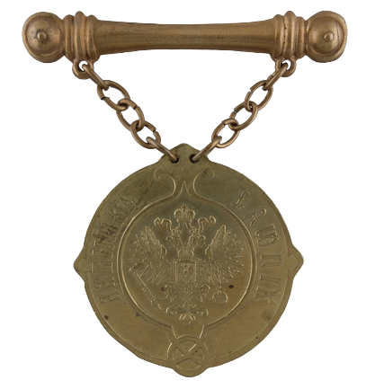
Table of Ranks
Introduced by Peter the Great in 1722 and used until 1917
A hierarchy of 14 categories for Russian military, navy, and civil service
Merit-based promotion (ability and performance) not birth and genealogy
Anyone who reached the 8th rank was granted hereditary nobility status
This upset the old aristocracy which lost its hereditary right to office and its exclusivity
Notes:
This is the medal worn by a collegiate assessor (Kovalyov’s rank in the story). It is a civil service (non-military) rank. It is rank 8 of 14 which means Kovalyov was granted hereditary noble status.

Slide 4
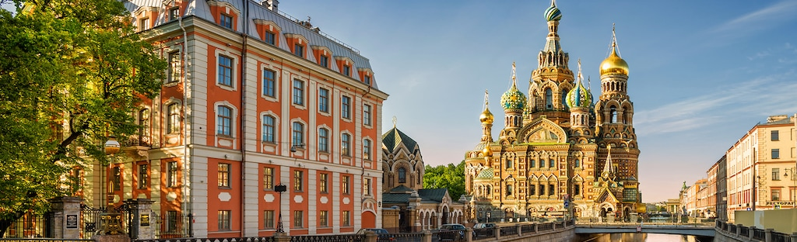
Setting
March 25-April 7, 1835 in St. Petersburg, Russia
Characters visit places like Issakievsky Bridge, Kazan Cathedral, and Nevsky Prospekt
Notes:
Ask the students where/when the story takes place. Have them give as much detail as they can remember from the story. What do they think of St. Petersburg based on the story?
St. Petersburg was the capital of Russia at the time the story was written. St. Petersburg was founded by Peter the Great in 1703. It was built using Western European cities as a model. The architecture and city layout are very different than Moscow. When Peter built the city, many serfs died in the process. It was given the epithet “city built on bones.” It was also seen as a foreign, Western, unnatural, almost anti-Russian city. It existed in opposition to Moscow. Gogol wrote a series of Petersburg tales in which strange things happen in the city. It is part of what is called “The Petersburg Text” in Russian literature. Other authors, like Dostoevsky, also depict the city as a place where strange and frightening things happen.
How does the setting relate to other story elements?

Slide 5
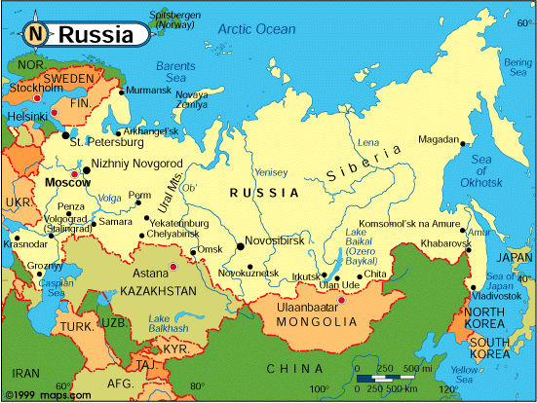
Russia
Notes:
St. Petersburg is in the northwest of Russia, on the Gulf of Finland.

Slide 6


Slide 7
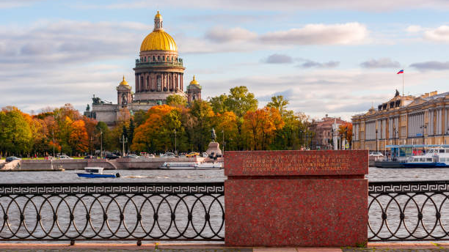
Issakievsky Bridge
Notes:
The Issakievsky Bridge was the first bridge constructed in St. Petersburg over the Neva River. It was named after St. Isaac’s Cathedral which is nearby. Here is a view of St. Isaac’s Cathedral from the Issakievsky Bridge.

Slide 8
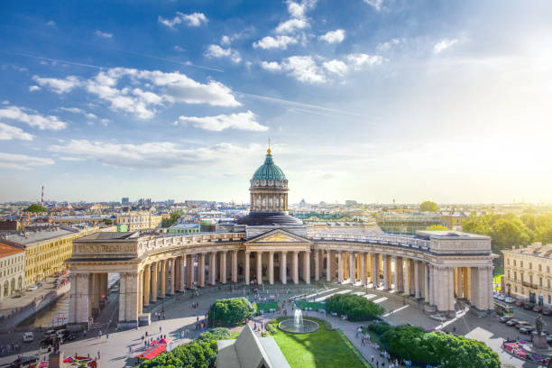
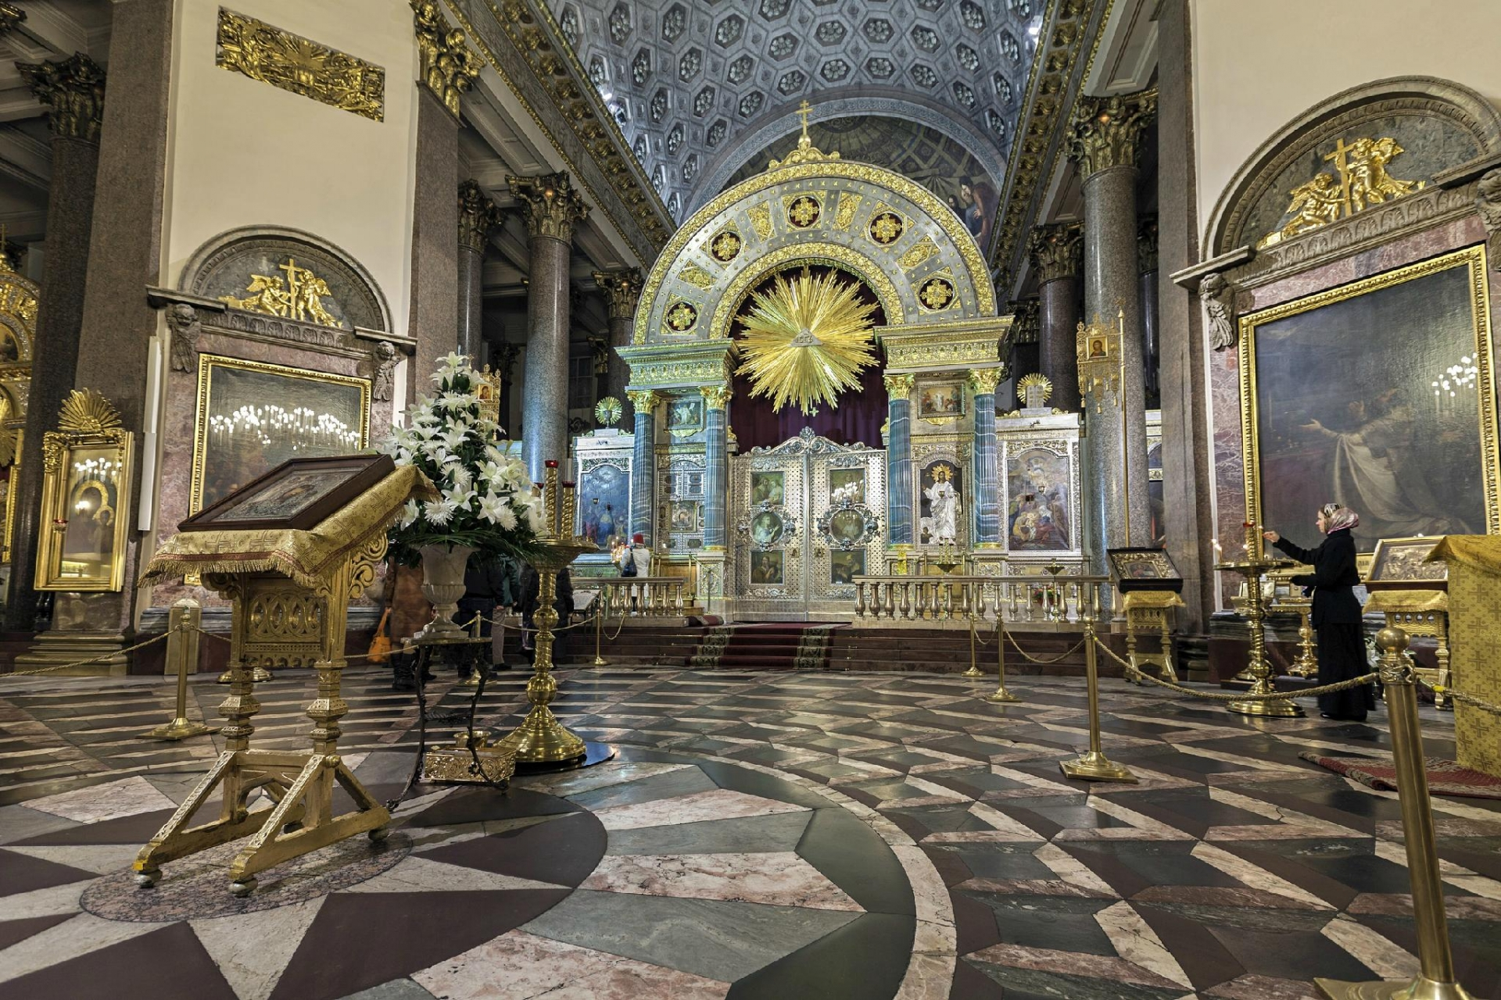
Kazan Cathedral
Notes:
This is Kazan Cathedral (Kazansky Sobor) in St. Petersburg. It is on the main street (Nevsky Prospekt). This is the cathedral to which Kovalyov follows his nose and sees it praying. The next image is of the interior of the cathedral.
Fun fact: The censor would not allow Gogol to publish “the Nose” until he changed the story so that the nose doesn’t go inside of the cathedral but goes to a shopping arcade instead.
Extra information: The cathedral is dedicated to Our Lady of Kazan, one of the most venerated icons in Russia. The cathedral opened in 1811. General Mikhail Kutuzov (who led the Russian army against Napoleon) is buried there.

Slide 9
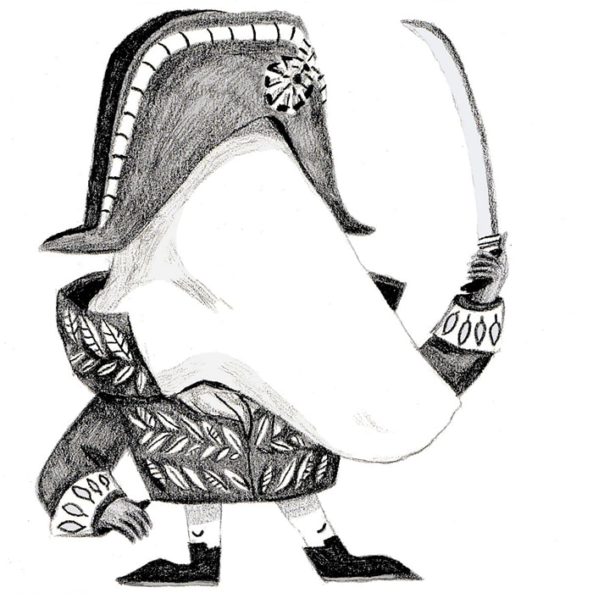
Characters
Ivan Yakovlevich, the barber
Collegiate Assessor Platon Kuzmich Kovalyov
The Nose (State Councilor in rank)
Notes:
A note on Russian names: Russian’s don’t have middle names, but something called a patronymic. It is derived from someone’s father’s first name and means son or daughter of _____. Therefore, the Kovalyov is Platon Kuzmich (son of Kuzma). In formal speech a person is referred to by their first name and patronymic. It’s similar to saying Mr. or Ms.
What do students remember about Ivan? How would they describe him in personality and appearance?
Kovalyov is a collegiate assessor. The story notes that he is not a “learned” collegiate assessor (“receive their title in consequence of their learned diplomas” but that he obtained his rank in the Caucasus, which was easier to do. This gives him a feeling of inferiority. The narrator notes that he refers to himself as Major Kovalyov, which is the corresponding rank in the military.
Ask your students: What details does the narrator give about Kovalyov that give the reader a sense of his personality?
What hierarchies exist in the story? How do they influence the characters?
The nose is a State Councilor, which is the 5th civil service rank and makes the nose a higher rank than Kovalyov.
Are the characters simple or complex? If complex, what makes them so? Are the characters static or do they develop?

Slide 10
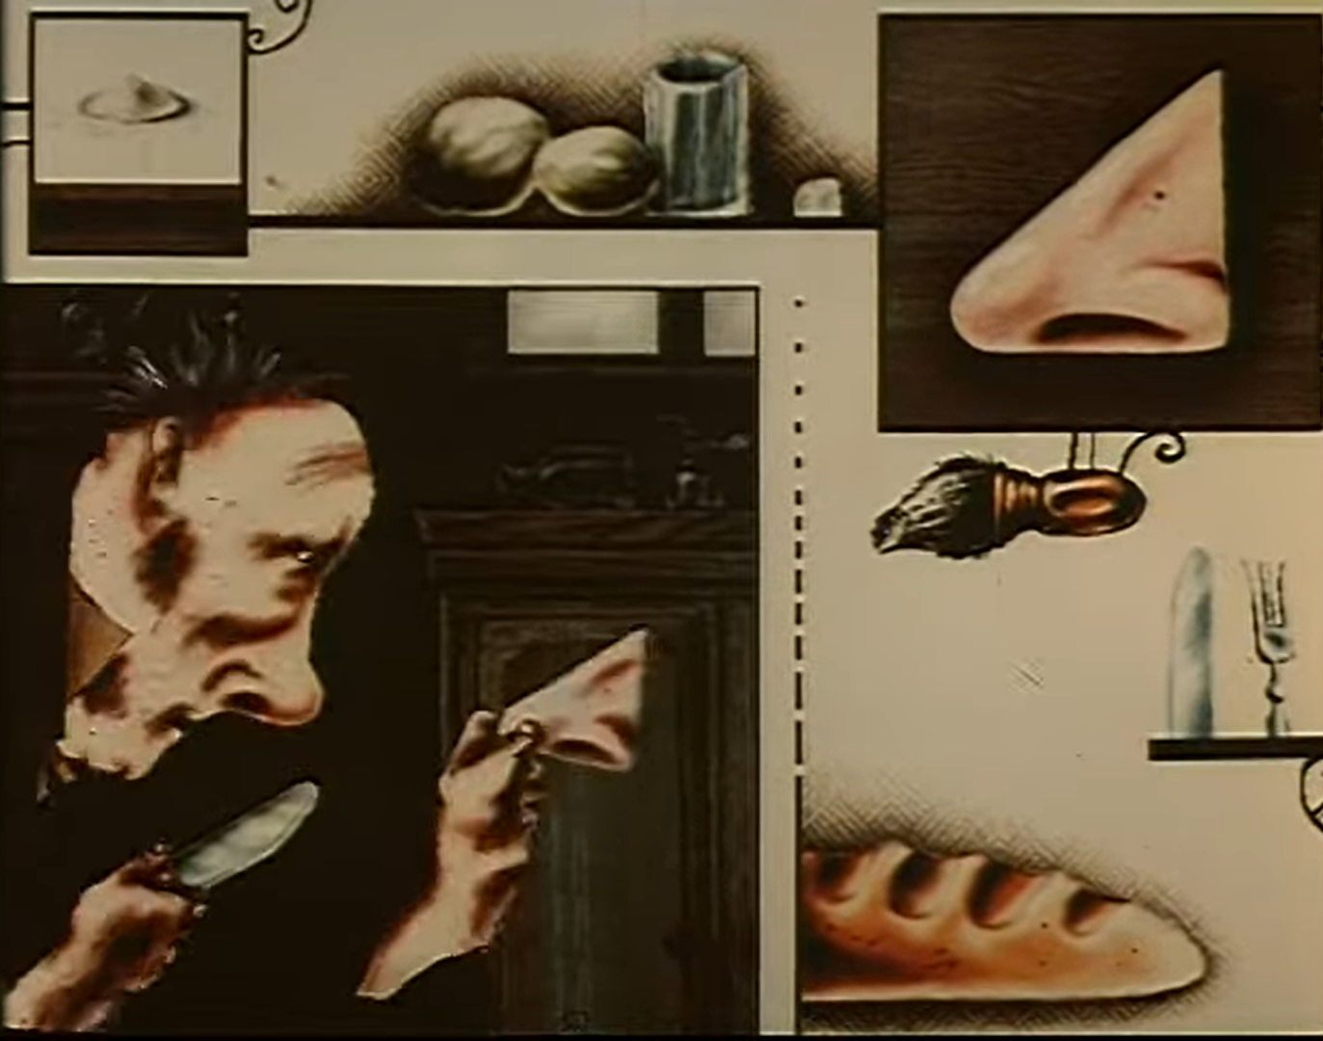
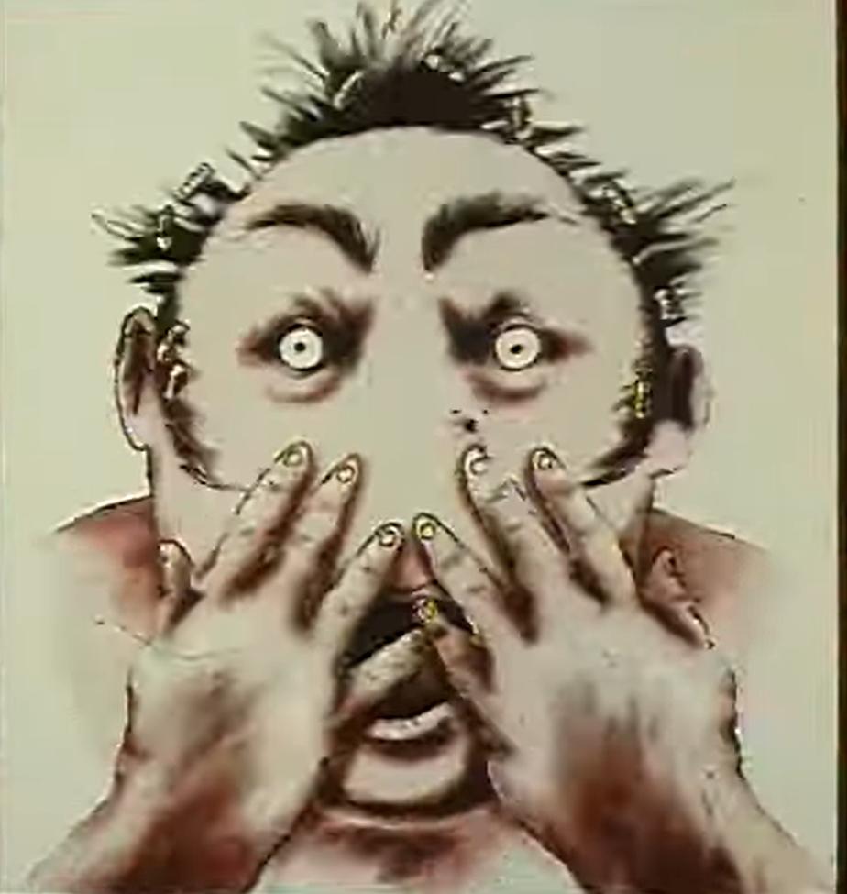
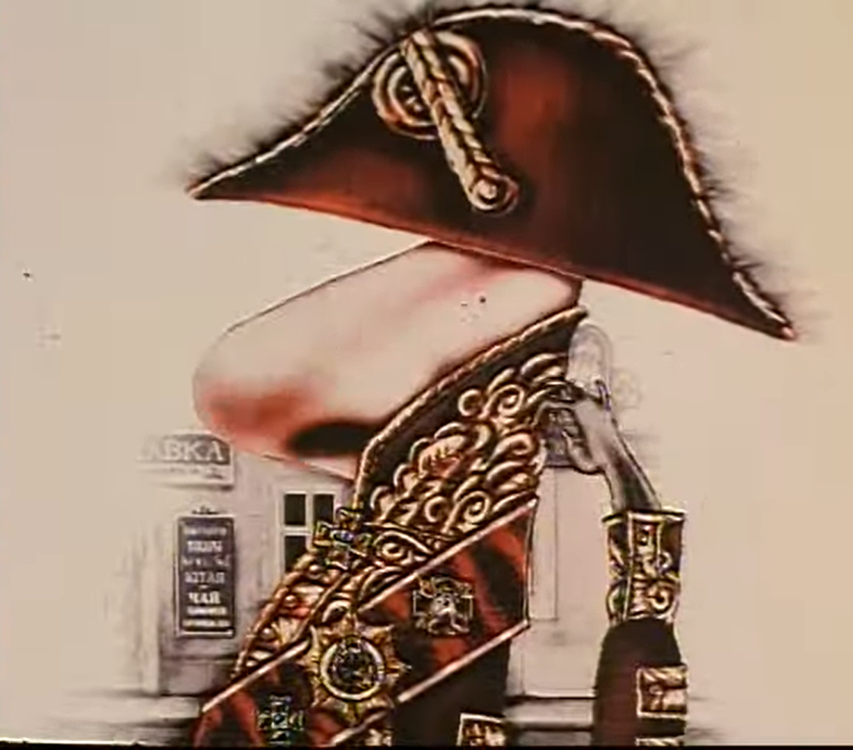
Plot
Notes:
Ask your students to retell the plot of the story. Is there one plot or parallel plots? Help them fill in any plot holes if needed. Try to have other students fill these gaps in before you help.
Main plot points:
The barber Ivan Yakovlevich wakes up on the 25th of March. His wife is baking bread. He cuts into one of the loaves and finds a nose inside (a familiar nose).
Ivan’s wife is angry with him for she assumes he cut the nose off one of his clients while shaving him.
What do students make of her reaction? Does it seem like a normal reaction?
Ivan’s wife tells him to get rid of it, and Ivan too is worried about the police catching him with it, so he wraps it in a rag and takes it out to dispose of it some how.
He keeps trying to drop it or stuff it somewhere but runs into people he knows. He tries to throw it off a bridge into the Neva River but is questioned by a police officer who knows he is lying about what he is doing. “but here the incident is completely shrouded in a fog and absolutely nothing is known of what happened next.”
Collegiate Assessor Kovalyov wakes up and sees that his nose is missing.
Kovalyov rushes off to the police, can’t find a cab so he has to walk.
On his way he sees a gentleman in a uniform get out of a carriage, that gentleman is his own nose, in the uniform of a State Councilor (higher rank than Kovalyov).
Follows the nose to the Kazan Cathedral where the nose piously prays. He doesn’t know how to approach the nose because it is a higher rank than he is.
The nose doesn’t understand what Kovalyov is talking about. It says he isn’t his nose but himself. He can tell from K’s buttons that they serve in different departments and therefore don’t know each other.
K loses sight of the nose when he is distracted by a pretty girl. When he can’t find the nose, he takes a cab to the police commissioner. The commissioner isn’t home, so he goes to the newspaper.
He tries to place an ad looking for his lost nose, but the clerk won’t let him, so he goes to find the police inspector.
What did students think of the interaction between Kovalyov and the newspaper clerk?
He feels insulted by the police inspector who won’t help him and so he goes home and tries to figure out who is behind the missing nose.
A policeman comes and says the nose has been found and that the barber is in jail. He has the nose in his pocket and gives it to Kovalyov.
He tries to figure out how to reattach the nose and eventually calls the doctor who can’t help him and advises him to live without a nose and even try selling his nose in a jar.
He writes to a woman who is trying to get him to marry her daughter, thinking she is behind it, but her response shows him she is innocent.
Rumors about the missing nose spread throughout town and people go out trying to see the nose.
“but here again a thick fog descends on the whole incident, and what happened afterwards is completely unknown.”
On April 7 Kovalyov’s nose is back in its proper place as if nothing had happened. He gets a shave from Ivan the barber who is astonished to see the nose back in place.
The story ends with the narrator musing about why authors would write about such absurd things but decides that these things do happen even if they are rare.
What do the students think of the ending?

Slide 11
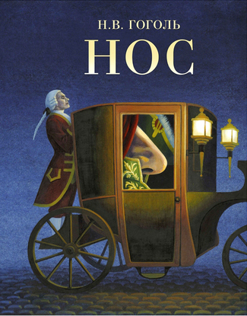
Themes
Rank and social standing/status
Appearance/masculinity/insecurity
Critique of Russian society and its absurdity/pretense
Notes:
Ask students what they think the themes of the story are.
Why do you think Gogol chose to write such an absurd story?
It is certainly a critique of Russian society at the time. Even though it is his own nose, Kovalyov is bound by societal norms and etiquette and has to address it with respect and reverence because the nose is of a higher rank than he is.
Gogol had a large nose and was self conscious about it and joked about it in a number of his letters.
What does the nose represent? Is it something specific to 19th century Russian society or to human nature in general?
The nose could represent what other people think of us, self-consciousness, societal judgement. Kovalyov can’t see his own nose, or lack there of, but he is terrified of going through life without one. It isn’t because he’ll never smell again, but about what others will think of him. He even says he’d rather lose a leg or an arm, but not his nose. This shows the power of others’ perception of us, vanity, and fitting the mold that goes with one’s position in society.
Some people see the nose as a phallic symbol.

Slide 12
Satire
The use of humor, irony, exaggeration, or ridicule to expose and criticize people's stupidity or vices, particularly in the context of contemporary politics and other topical issues.
Notes:
Can the students define satire?
What are some examples of satire that they might be familiar with, maybe a movie or tv show?
Family guy satirizes the American middle class
Shrek satirizes fairy tales
The Onion satirizes American news

Slide 13
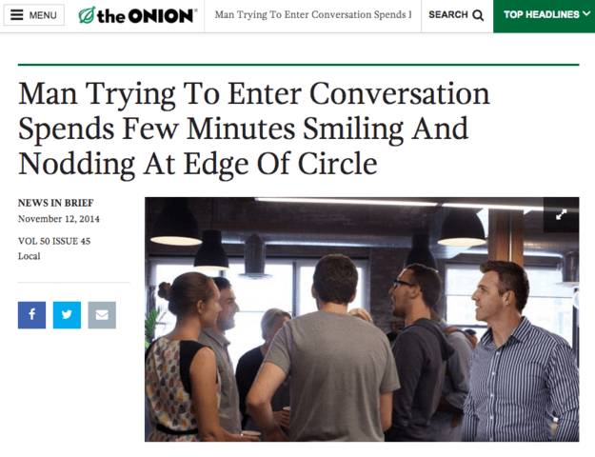

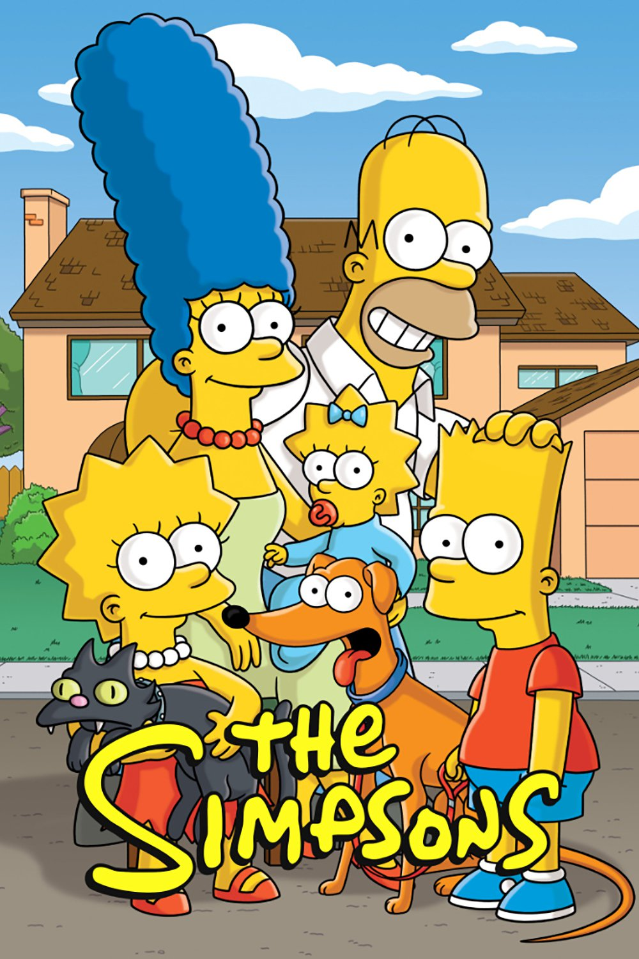

Satire
Notes:
Can the students define satire?
What are some examples of satire that they might be familiar with, maybe a movie or tv show?
Family guy and the Simpsons satirize the American middle class
Shrek satirizes fairy tales
The Onion satirizes American news

