Slide 1
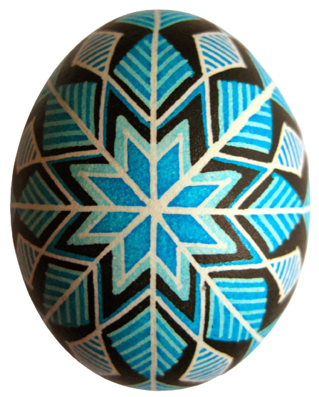
Learning Shapes with Pysanky
(Ukrainian decorated eggs)

Slide 2
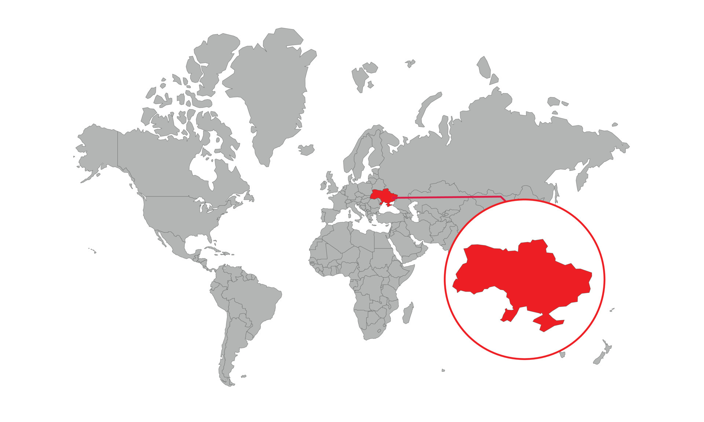
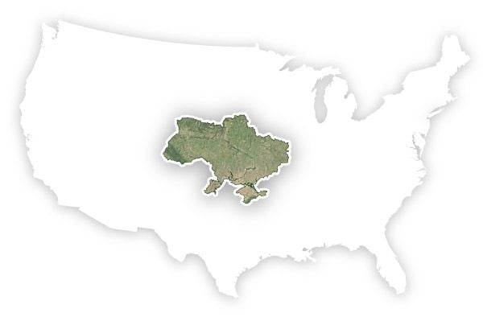
Where is Ukraine?
How big is Ukraine?
Notes:
If they already know their continents, you can tell them Ukraine is in Europe. It is the second largest country in Europe.
Then show them how big Ukraine is compared to the United States. Ukraine is 233,060 square miles. For comparison, Texas is just slightly bigger at 268,597 square miles. It’s almost twice as large as the size of California.

Slide 3
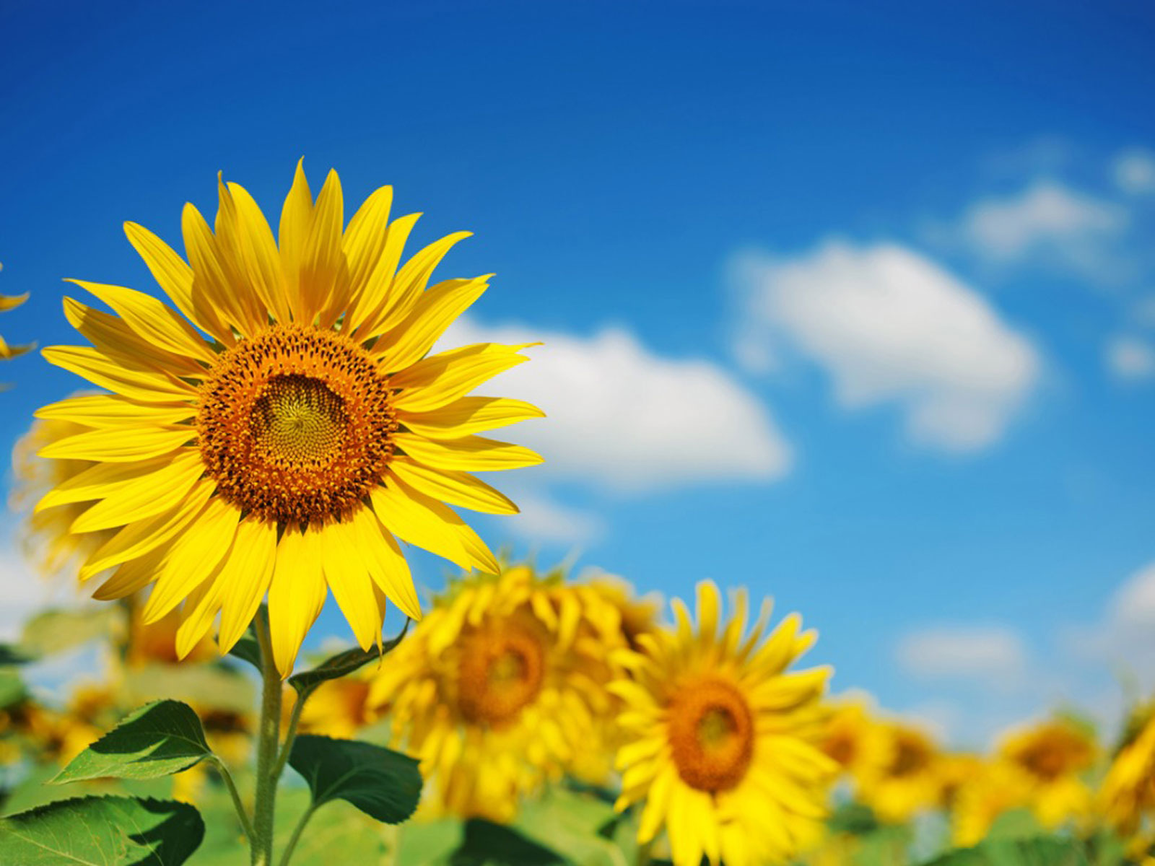
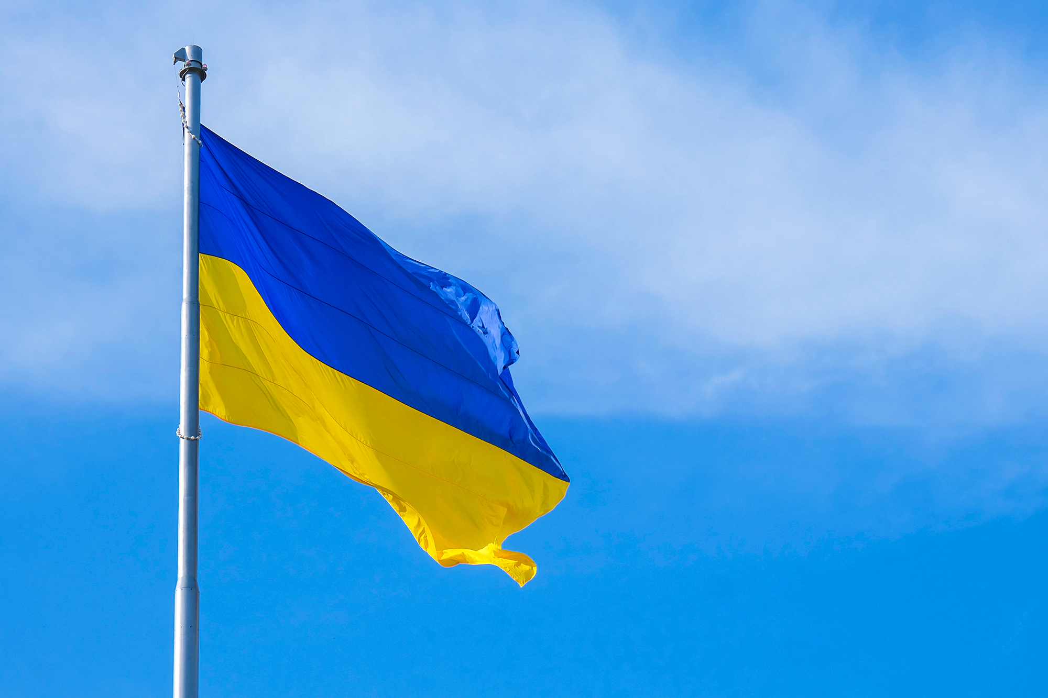
They speak Ukrainian and Russian in Ukraine. They have a different alphabet called the Cyrillic alphabet.
The national flower of Ukraine is the sunflower
The Ukrainian flag is blue and yellow.
Notes:
If you want you can tell them that Russian and Ukrainian both use the Cyrillic alphabet but have a few letters that are special to their language. Ukrainian and Russian are both Slavic languages. They are similar but not the same.
The colors on the Ukrainian flag symbolize the blue sky and a yellow field of wheat. You can tell them Ukraine has a lot of wheat just like Kansas does.

Slide 4
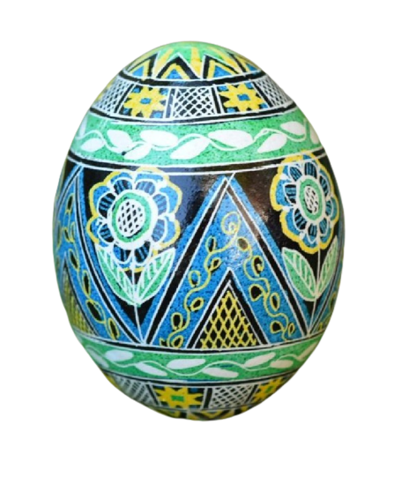
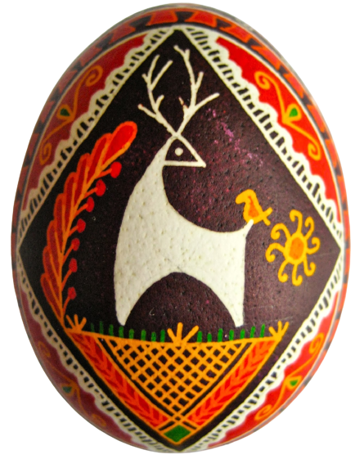
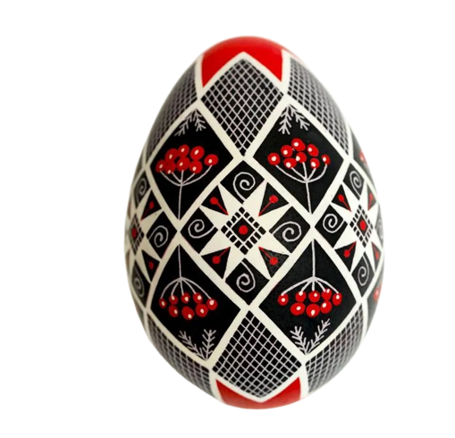
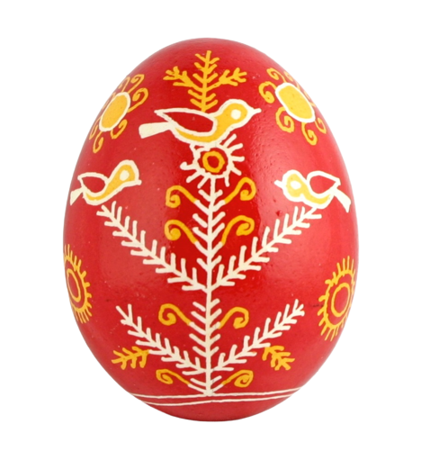
They make pysanky in Ukraine. Pysanky are decorated eggs.
Notes:
Ukrainians started making pysanky hundreds and hundreds of years ago. The traditional designs are colors are really old! The word pysanky comes from the Ukrainian word pysati which means to write. People write on the eggshell with hot wax and then dye the egg. Each design has a special meaning.

Slide 5
Watch someone make a pysanka.

Slide 6
Let’s learn shapes!
Triangle
Circle
Square
Notes:
Show them the shapes and see if anyone already knows what they are called.
If not, have them help you describe the shapes and then give them the names.

Slide 7
Let’s learn shapes!
Oval
Rectangle
Hexagon
Notes:
Show them the shapes and see if anyone already knows what they are called.
If not, have them help you describe the shapes and then give them the names.

Slide 8
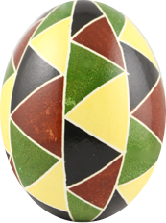
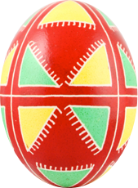
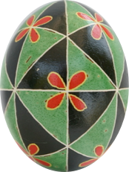
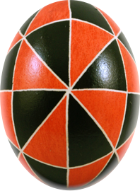
What shapes do we see in these pysanky?
Notes:
Ask them what shapes they see in these four pysanky. Ask them what shape the egg itself is.

Slide 9
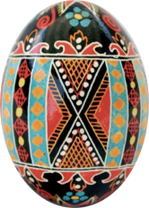
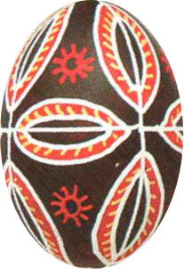
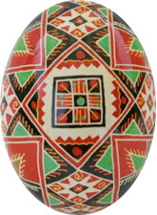
What shapes do we see in these pysanky?
Notes:
Triangles
Squares
Circles
Rectangles

Slide 10
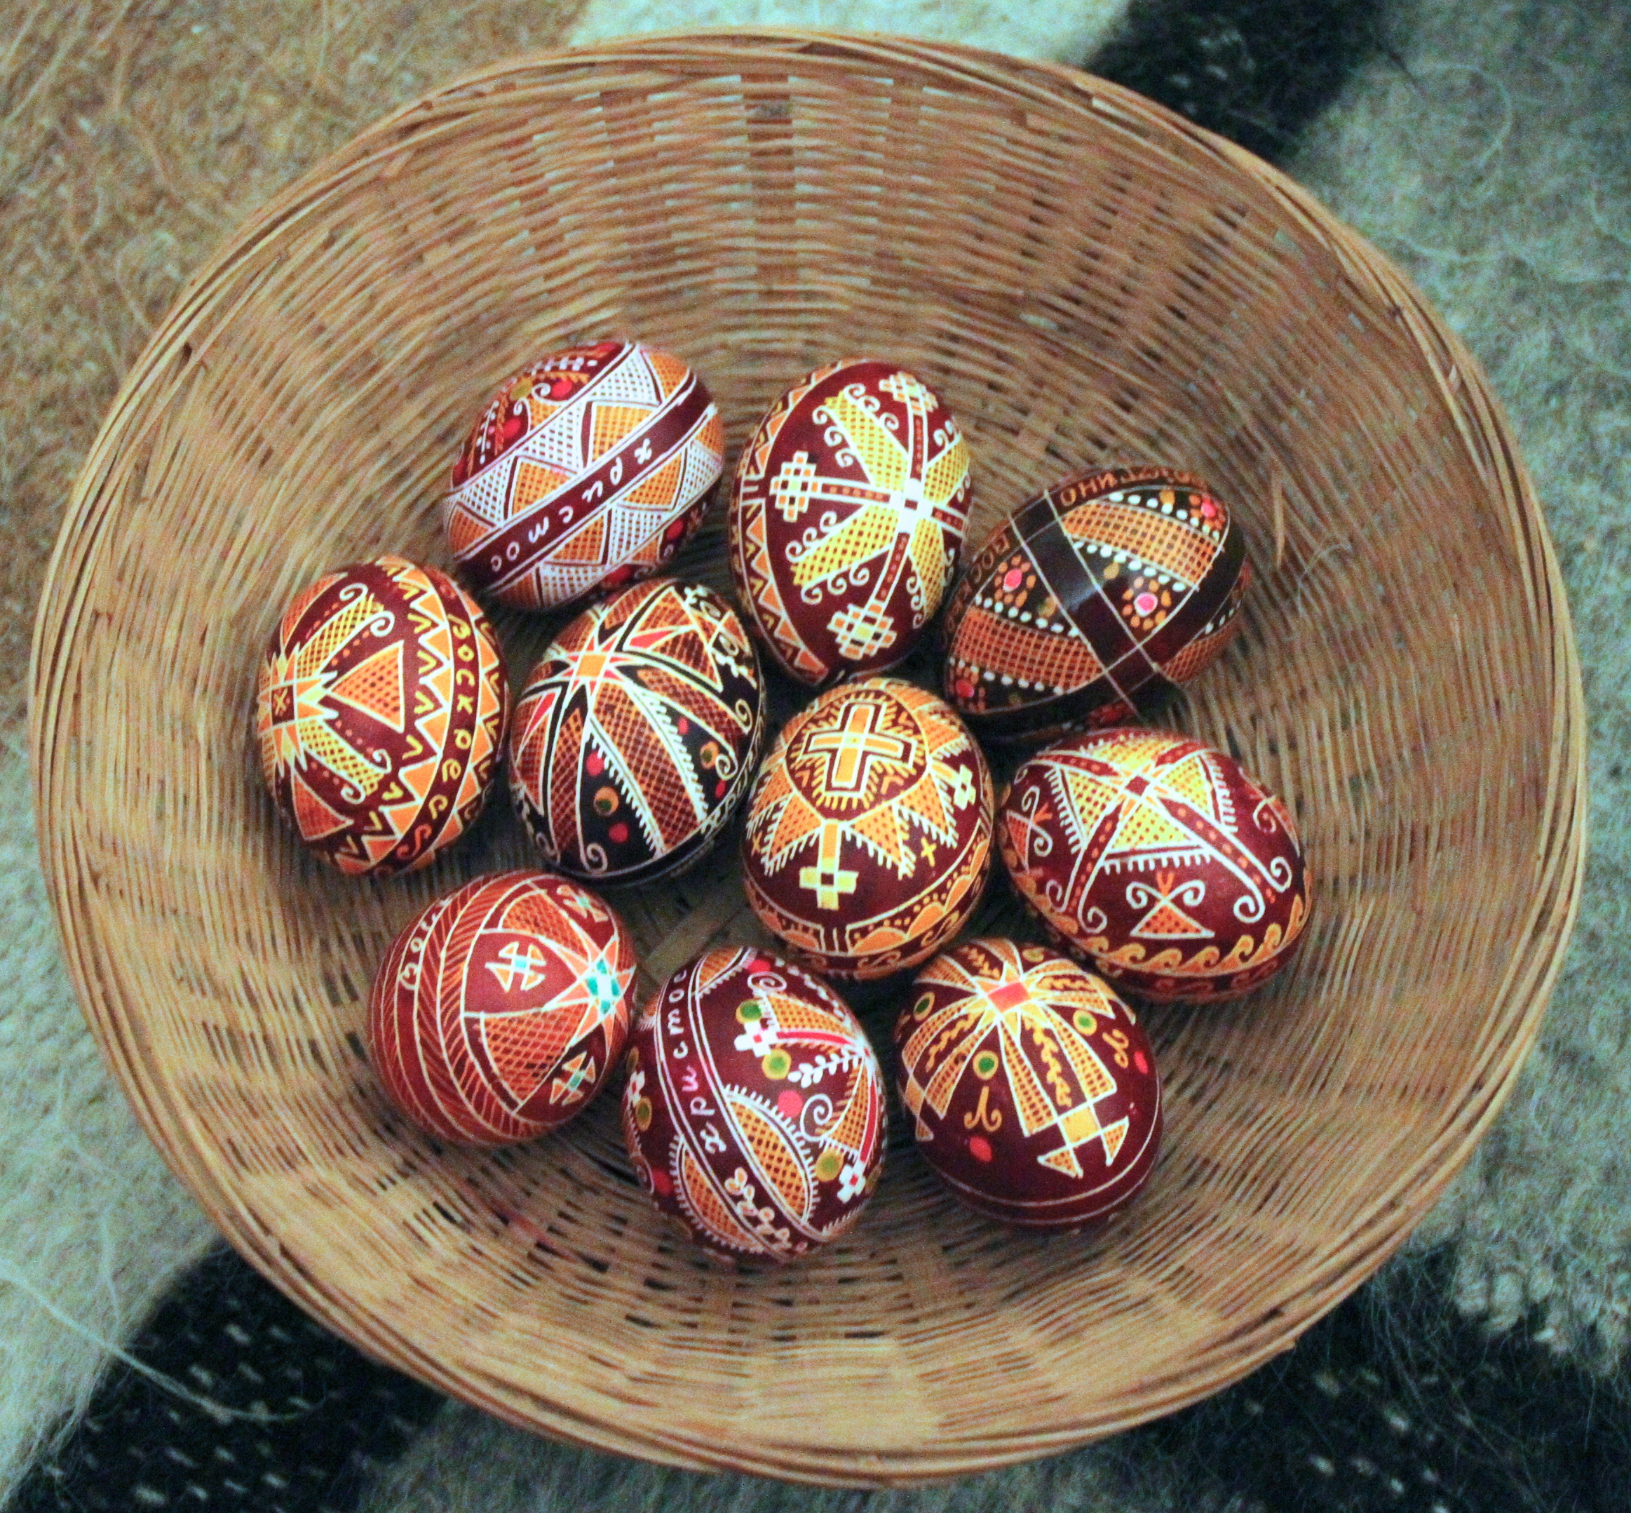
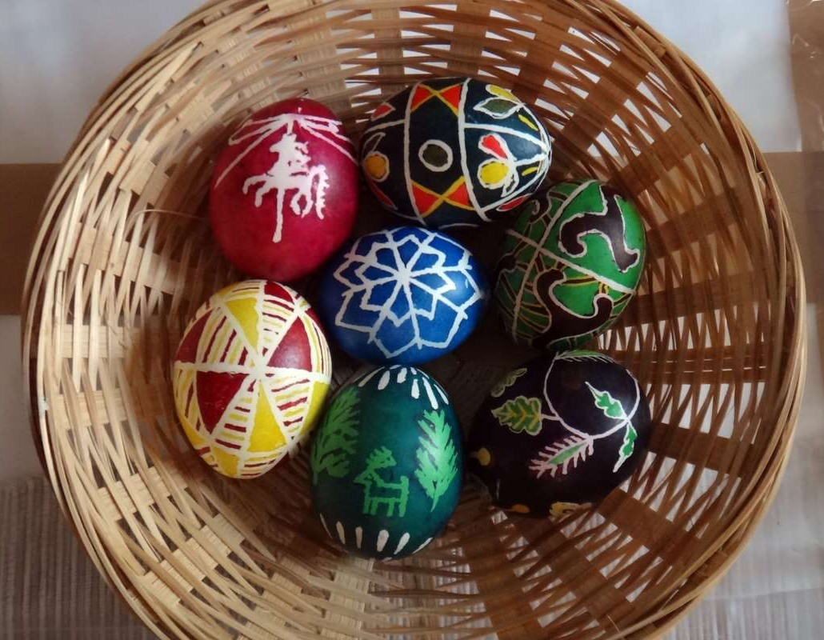
Which basket has more pysanky?

Slide 11
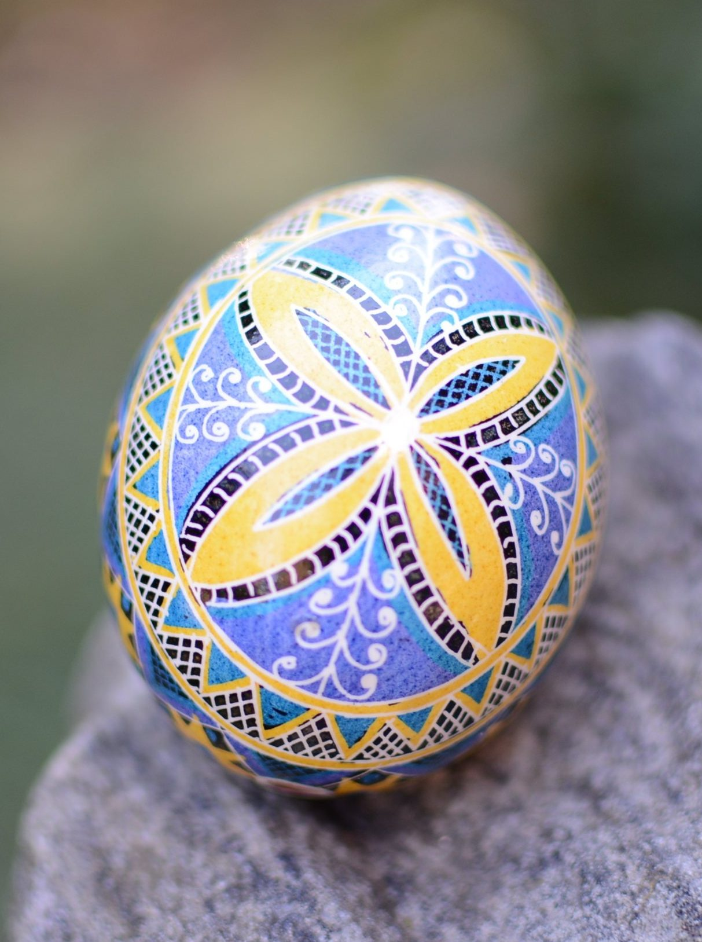
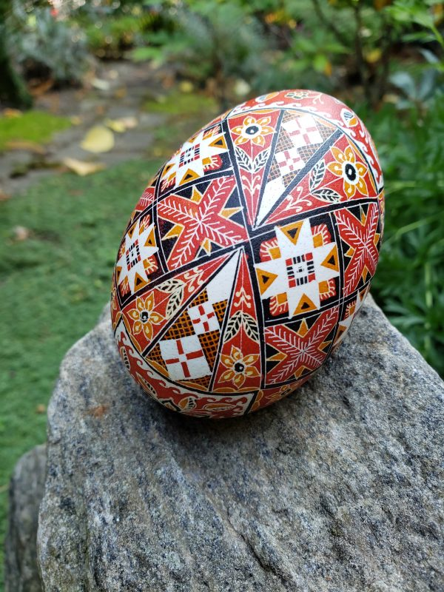
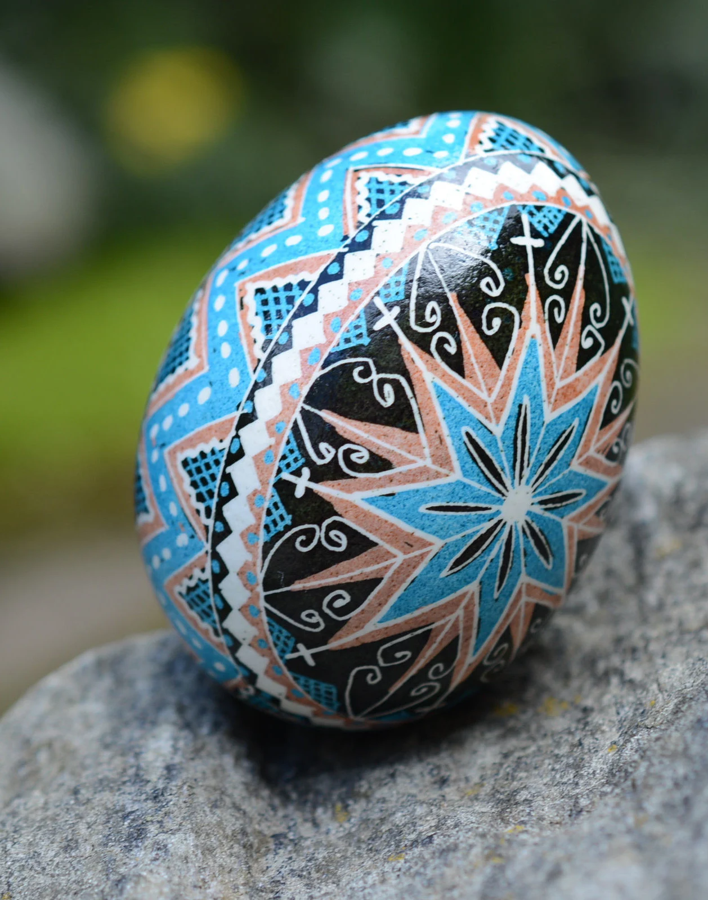
Which pysanky have triangles? Which have squares? Which have both?
Notes:
Can they see any other shapes in any of these pysanky?

Slide 12
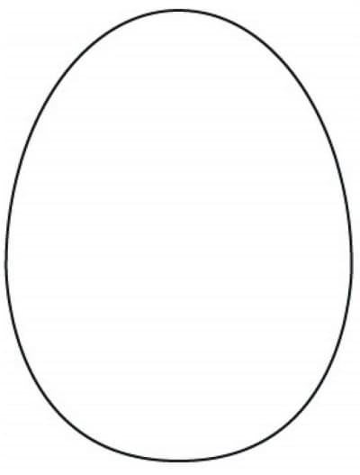
Can you decorate your own pysanka using the shapes we learned?
Notes:
Pass out the blank egg paper and have them decorate their own pysanka. Make sure they are drawing the shapes they learned today (triangle, circle, square, rectangle, hexagon, oval). As they are working, walk around and have them describe their egg. What shapes did they use?

Slide 13
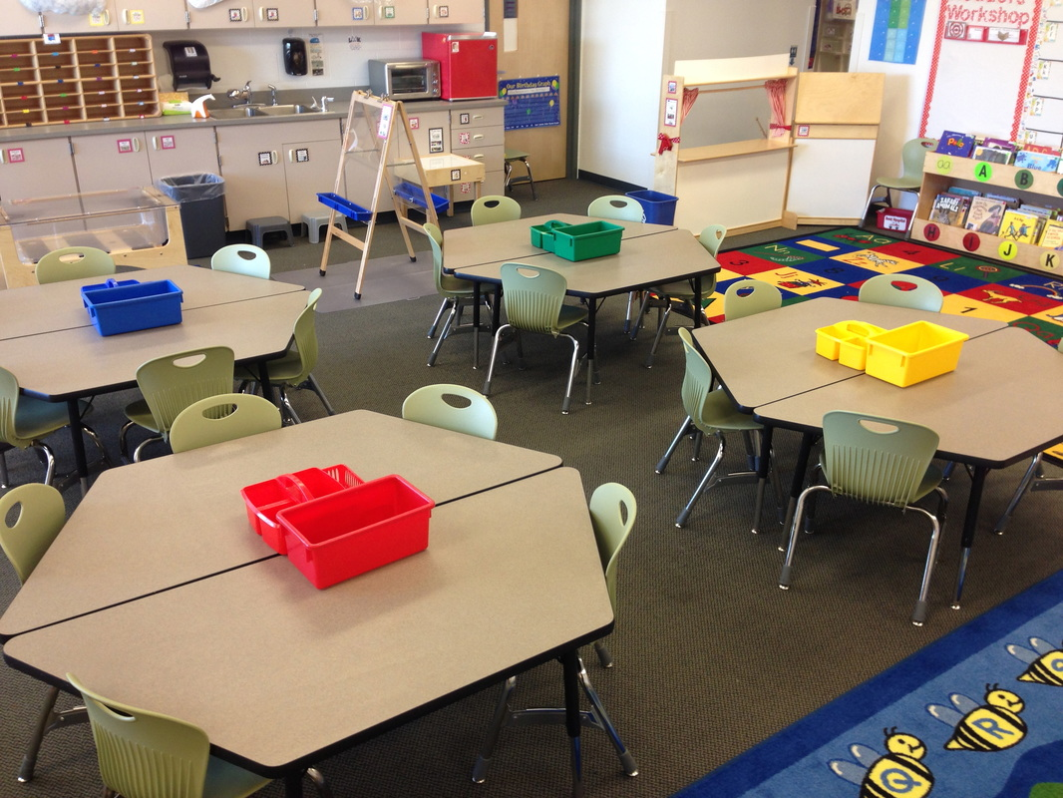
What shapes do we see around the room?
Square
Hexagon
Circle
Oval
Rectangle
Notes:
Ask them to look around the classroom and identify shapes that they see. Do a few together to start.

