Slide 1
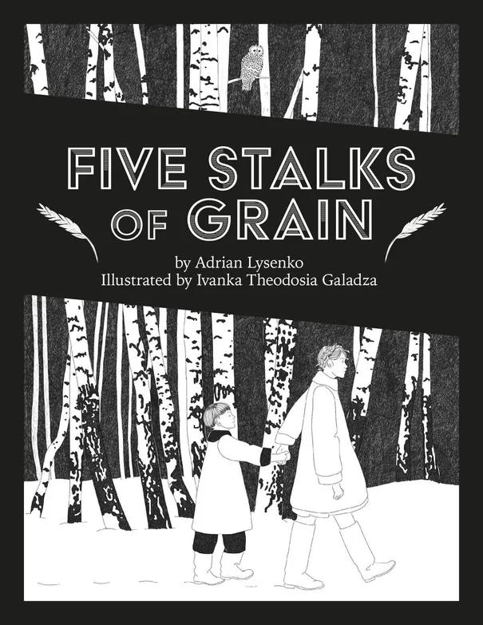
Overview of Cultural References
Prepared by the KU Center for Russian, East European, and Eurasian Studies (CREES)

Slide 2
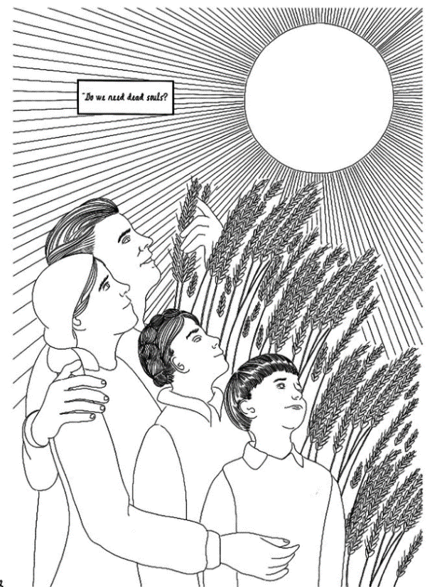
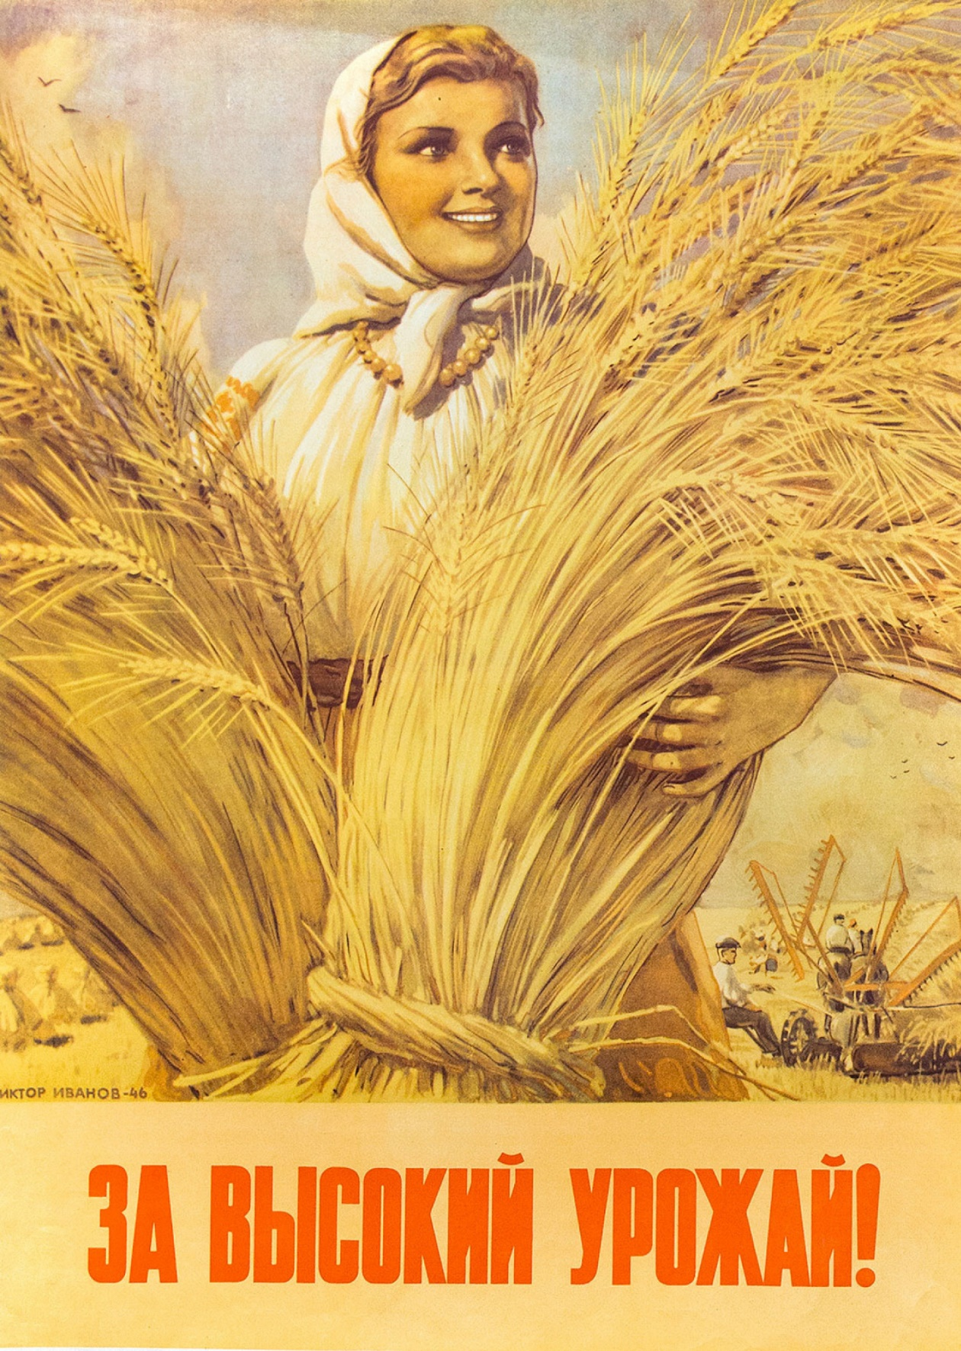
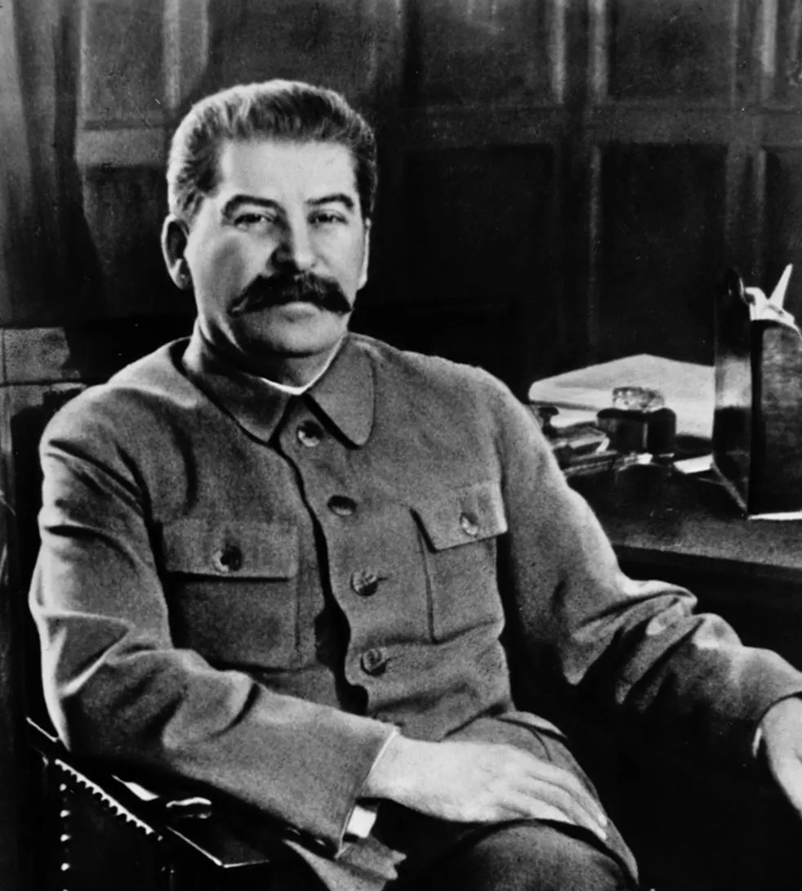
Joseph Stalin and Collectivization Propaganda
“Primarily, it is so-called dead souls that are withdrawing from the collective farms—It is not even a withdrawal but rather the revelation of a vacuum—” “Do we need dead souls? … Of course not.”
-Joseph Stalin
Notes:
Page 1-3 Stalin Quote
This is a quote from Soviet Leader Joseph Stalin (1878-1953) who lead the USSR from 1924 until his death in March 1953. You can start by asking your students who Stalin was. Fill in any important details they missed.
The quote is from Stalin’s “Reply to Collective Farm Comrades” published in the newspaper Pravda in April 1930. In the reply, Stalin states that many people from the collective farms had written him letters with various questions. Instead of respond individually, he responds to many of the questions in this article. The quote is from this article in response to the question “How is the exodus of a section of the peasants from the collective farms to be assessed?” In an earlier part of his answer to this question he says “The exodus of a section of the peasants signifies that of late a certain number of unsound collective farms were formed which are now being cleansed of their unstable elements. That means that sham collective farms will disappear while the sound ones will remain and grow stronger.” As your students what they think “cleansed of their unstable elements” means and call attention to the dehumanizing language and casual attitude toward loss of life for the sake of the Soviet mission of collectivization.
Stalin’s attitudes toward the loss of life during the famine can be summarized by one of his most famous quotes, “If only one man dies of hunger, that is a tragedy. If millions die, that’s only statistics.”
The phrase ‘dead souls’ is a reference to the 1842 novel by Nikolai Gogol. Gogol, a Ukrainian by birth, wrote in Russian and many of his works were comical and satirical commentary on 19th century Russian society. Gogol’s novel Dead Souls tells the story of Pavel Chichikov who goes around different estates purchasing ‘dead souls.’ This phrase refers to serfs who had died but were not yet struck from the census. A landowner’s wealth was partially determined by the number of souls (serfs) he owned.
The picture on the second page is interesting because it resembles Soviet propaganda posters. Often, people were portrayed as looking off happily into the distance, which implied they were looking toward the dazzling future of communism. This is the only page in the novel that shows the entire family together. At the beginning of the novel we learn that the father was arrested for refusing to join the collective farm. The mother is killed, accused of hoarding grain. The children are eventually separated on their journey to find food in the city. The visual reference to propaganda posters on this page is interesting in that it indicates how far from reality these images really were. On paper, the family is united and surrounded by life-giving wheat and the sun. In reality, the family was torn apart and starving.

Slide 3
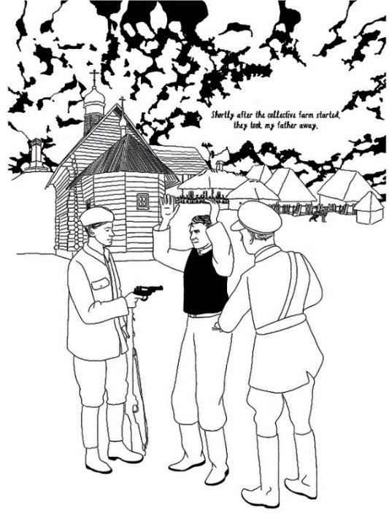
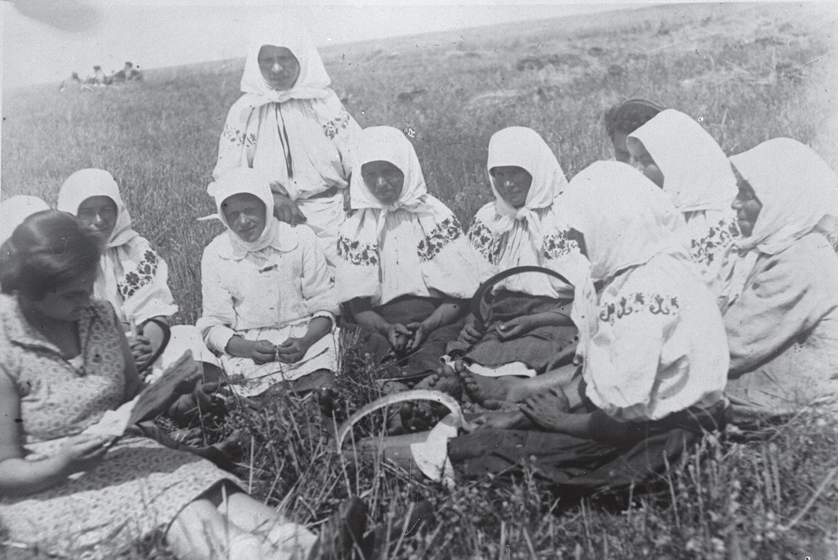
Collective Farms
Notes:
Page 5: Collective Farm
The collective farm was called a kolkhoz. In Russian, kolkhóz is a contraction of коллективное хозяйство, kollektívnoye khozyáystvo, which means collective farm. These were farms owned jointly by the commune or the state. Before collectivization in Ukraine, farmers privately owned and operated their own farms. Members of collective farms had to forfeit their private property, that is land, livestock, and tools, to the collective. They did not earn their own money, but instead were paid day wages. Farm equipment, like tractors, would be leased from a centralized, state-owned institutions. The state set up very high grain production quotas for the collective farms, so high that they were impossible to fulfill. Collectivization actually led to less grain production than was seen with private farms. Nonetheless, in 1932, grain production quotas were raised. This meant that grain that farmers would have kept to feed themselves and their families was taken to fulfill the quotas. This grain was sent to other parts of the Soviet Union or sold abroad. Farmers didn’t have anything to feed themselves, which resulted in famine.
The state pushed collectivization on the farmers. Groups sent by the state came to the villages to set up the farms and convince peasants to join the kolkhoz. Many people resisted joining the collective farms, including Nadia and Taras’ father in the novel.
This photo is a staged photo of women on a collective farm taken in Vinnytsia in 1932-1933. It depicts what Stalin wanted visitors to the USSR to see in Ukraine. The women are dressed in clothing reserved for special occasions, not for fieldwork. Collectivization was supposed to happen spontaneously, the result of enthusiasm for the cause in the rural areas. Showing people in good clean clothes, resting and reading in the fields, presented collectivization as a profitable endeavor that allowed for down time. Instead, it was forced onto farmers by the state from above, was incredibly taxing in terms of labor, and led to the Holodomor famine.
This could be an interesting point to talk to your students about how images are not always what they seem. You can compare it to what they see on social media. Images are manipulated, like with filters, or staged, to convince the viewer of one thing, when the reality is quite different.

Slide 4
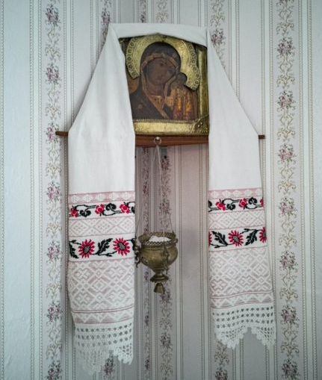
The Icon Corner
Notes:
Page 10: Red Corner or Icon Corner.
The Red Corner is where Orthodox people place icons. It is a worship space within the home. Icons were normally faced to the east. Icons were placed in the corner to eliminate distractions and allow more concentrated prayer. The cloth decorating the icon is a bozhnik, a ceremonial embroidered cloth. Bozhnik comes from the word Boh, which means God in Ukrainian. Learn more about the red corner at www.rbth.com/lifestyle/335163-red-corner-meaning
The officer is inspecting the icon corner because the Soviet Union was an atheist country. Religion was outlawed. Therefore, it was not permissible to have icons in the house. In Soviet times, the red corner became a place where people would place portraits of Lenin and Stalin. According to the Museum of Russian Art, “In the 1920s, most churches were closed or destroyed, the majority of priests arrested and exiled. Icon-painting became an illegal trade punishable under Article 152 of the Soviet Criminal Code by four years of prison. Set up under Stalin, the Society of Militant Atheists proclaimed that, by 1937, ‘not a single house of prayer shall remain in the USSR and the very concept of God must be banished from the Soviet Union as a survival of the Middle Ages..”

Slide 5
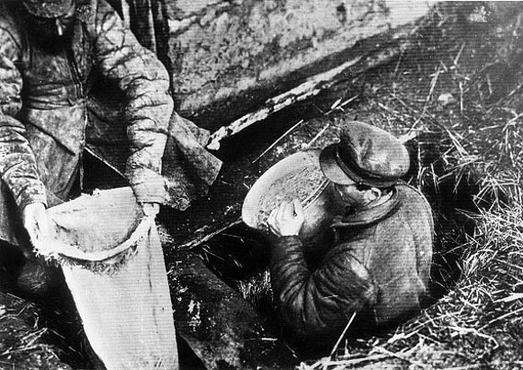
Grain Hoarding
Notes:
Page 11: Grain hoarding
This is an image of Soviet officials confiscate grain from a peasant household in Ukraine in the early 1930s. Image source: Internet Encyclopedia of Ukraine.
Impossibly high grain production quotas caused all grain to be taken by the state and sent to the cities or sold abroad. This meant that families had nothing left to feed themselves. Out of necessity, many kept grain in secret to stay alive. If the state found out, the grain would be confiscated and the grain hoarders would be arrested or executed. The state gave orders to arrest or execute people who took grain from the fields or storage facilities.
In the novel, police show up to Nadia and Taras’ house and accuse their mother of grain hoarding. We don’t see if she was or not. An accusation could be all it took for an arrest (or worse) to be made.

Slide 6
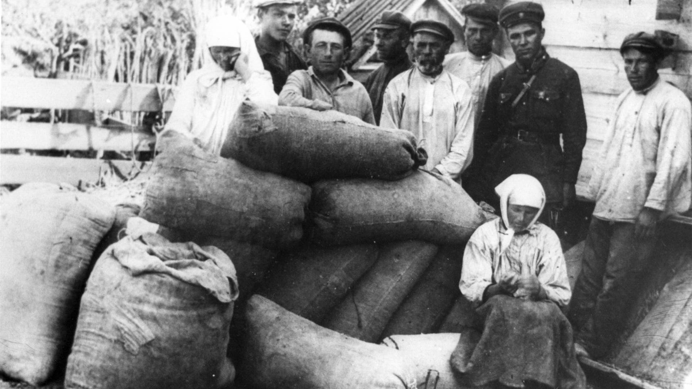
Grain Hoarding
Notes:
GRAIN CONFISCATED FROM A FAMILY DERIDED AS "KULAKS" IN THE VILLAGE OF UDACHOYE IN UKRAINE. Photo credit SOVFOTO/UIG/GETTY IMAGES via history.com
A kulak (from the Russian word for fist) was the term used for a rich peasant and considered enemies of the Soviet state. Often people were accused of being kulaks if they resisted collectivization of agriculture. Phrases like “liquidation of the kulaks” or “dekulazization” were used.

Slide 7
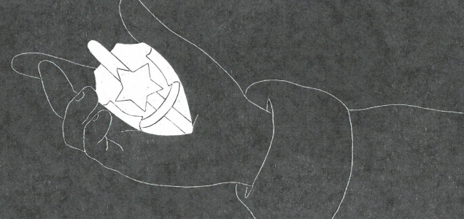
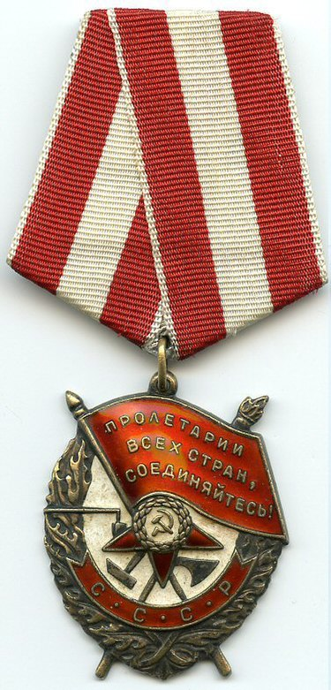
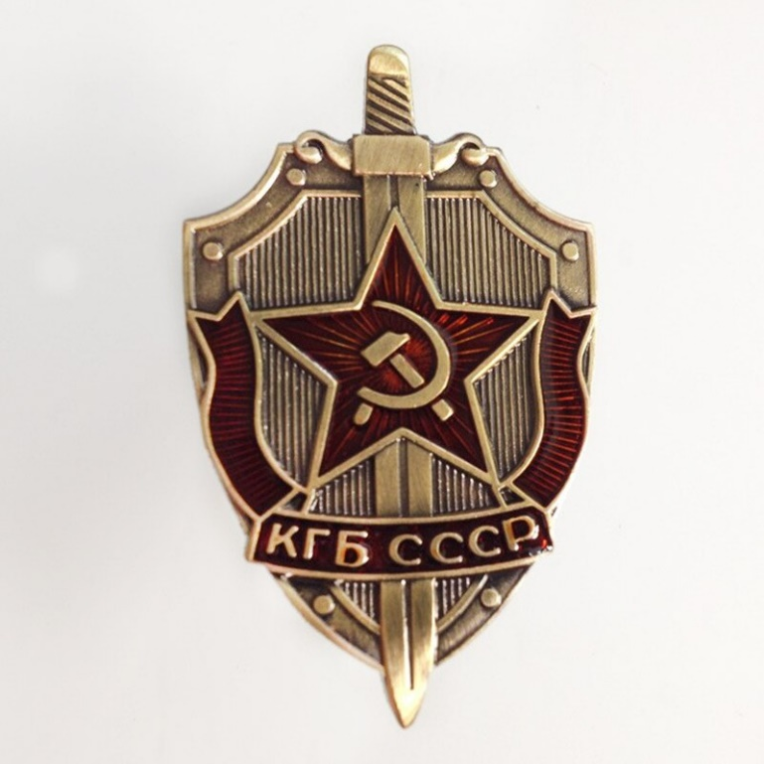
Order of the Red Banner
KGB of the USSR
Notes:
Page 23/43/62/79: Order of the Red Banner Medal
Order of the red banner pin given for heroism in combat. Nadia finds this medal in an old coat pocket and later tells her brother Taras how her father received the medal for his bravery when he led the soldiers back to their village during the Revolution.
The image in the novel is a bit confusing. The pin is referenced as the Order of the Red Banner (photo on the right) however the actual graphic seems to be based on the emblem of the KGB (photo on the left). It cannot actually be a KGB pin since the KGB was established in 1954. The artist seems to have chosen the KGB pin as a reference because it lends itself to black and white graphics more easily. It is an example of artist license and/or historical inaccuracies in literature.

Slide 8
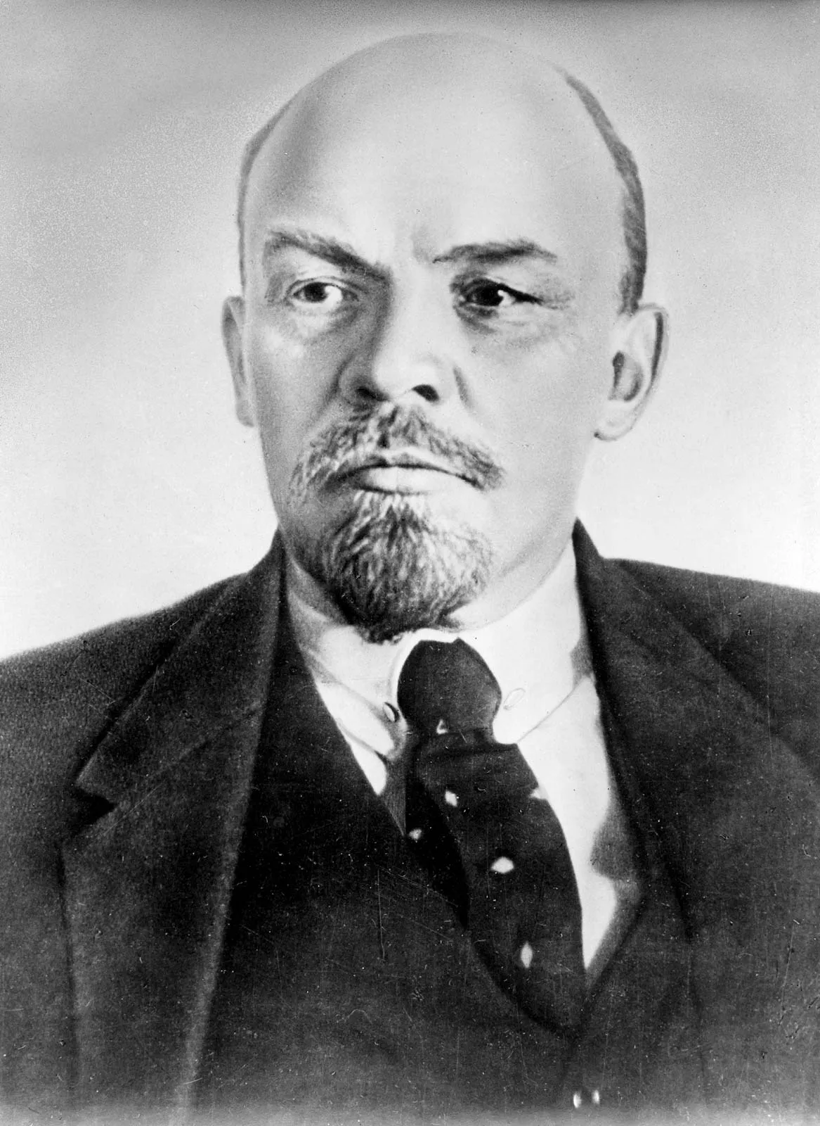
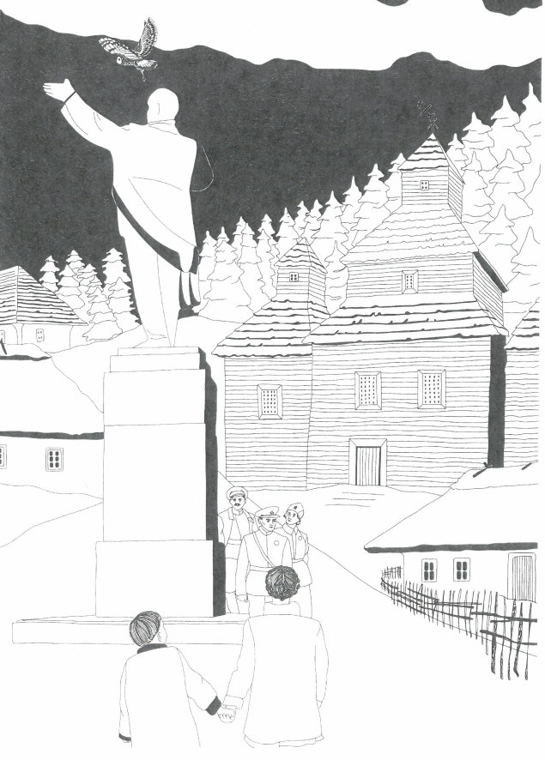
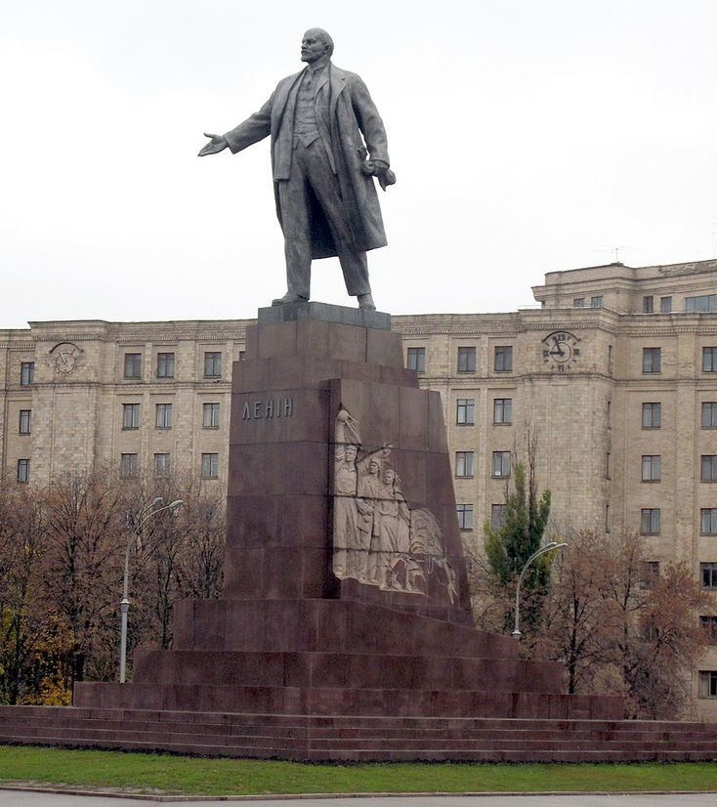
Lenin
Notes:
Page 26-27 Statue
Though we can’t see his face, the statue depicted on these pages is most likely Vladimir Ilych Lenin.
Lenin’s real name was Vladimir Ilych Ulyanov. He was born in 1870 and died in 1924. He was a Marxist and the founding head of the Soviet government. A cult of personality developed after his death. Lenin became a symbol of the revolution and of the Soviet mission. St. Peterburg Russia was renamed Leningrad and there were statues and portraits of Lenin everywhere. His body remains, to this day, on display in the Lenin Mausoleum on Red Square. Stalin helped create a secular religion Soviet Communism and Lenin was its patron saint.

Slide 9
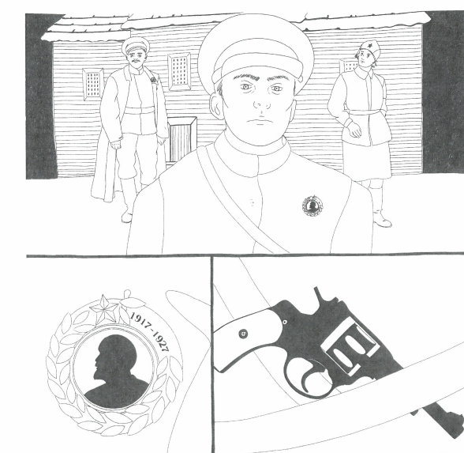
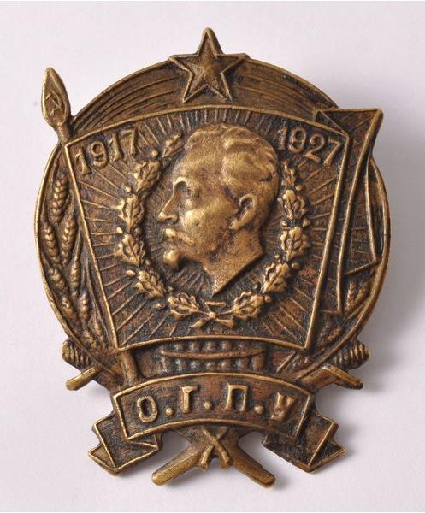
OGPU Badge
Notes:
Page 28 Pin with silhouette and dates 1917-1927
This is most likely the 10th anniversary badge of the OGPU. OGPU stands for Объединённое государственное политическое управление (pronounced obyedinyonnoye gosoodarstvennoye politicheskoye oopravleneeye) which means Joint State Political Directorate. It was the intelligence and state security service and the Soviet secret police from 1923 to 1934. This is one of the precursors of the KGB.
The artist has created a version of this pin that lends itself better to black and white graphics. The badge features a portrait of Felix Dzerzhinsky in the center. Dzerzhinsky was a revolutionary who led the first two Soviet secret police organizations, the Cheka and the OGPU from 1917 until his death in 1926. “Dzerzhinsky, who organized the first concentration camps in Russia, acquired a reputation as an incorruptible, ruthless, and fanatical communist” (Britannica.com) He was a firm supporter of Stalin.

Slide 10
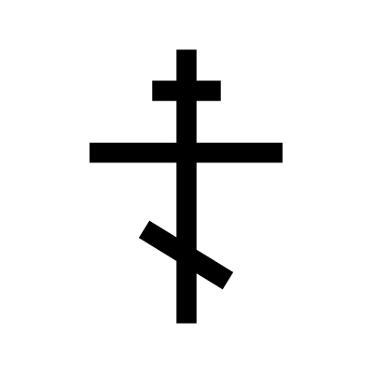
The Orthodox Cross
Notes:
In case students are wondering why this cross looks different from what they are used to seeing, this is the cross used in Eastern Orthodoxy, the main religion in Russia and Ukraine.
According to Bridge to Moscow, “The cross usually has three crossbeams, two horizontal and the third one is a bit slanted. The top bar symbolizes the sign that was hung above the head of Christ, it was written: "Jesus of Nazareth, King of the Jews.” The middle bar was where Christ's hands were nailed. The lower bar is the foot-rest. According to the Russian Orthodox tradition the feet are depicted as being nailed not at one point but individually at the two sides of the footrest. The slanted line reminds us of the two thieves on both sides of the cross. One of them to the right of Christ ascended to Heaven, while the other one sank to Hell. Thus bottom bar of the cross is like the scale of justice and its points show the way to the Hell and Heaven. Another interesting fact is that the upper point of the slanted beam always show the way to the North. Thus a church cross can serve as a compass.”

Slide 11
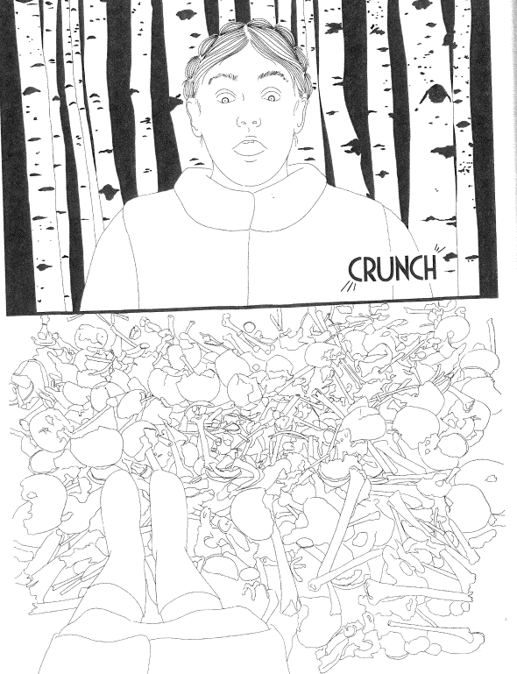
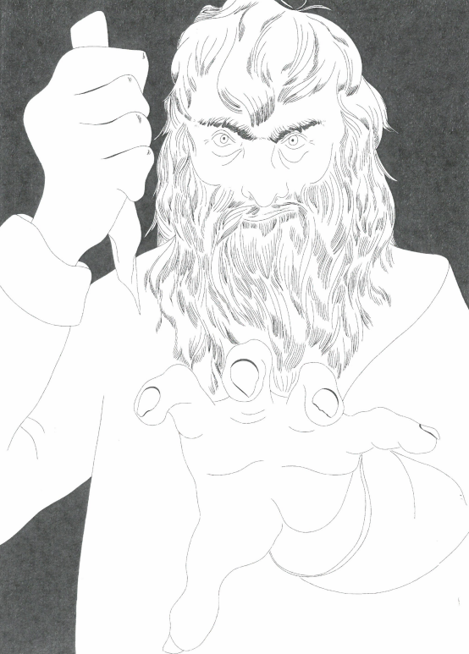
Cannibalism
Notes:
Page 38 Man in the woods
On page 30, Nadia and Taras meet a man who offers them fresh bread. Afraid of the OGPU officer, they follow the man into the woods. Page 32 shows that he grasps Nadia’s hand hard enough to make her a little nervous. On pages 33 and 34 he sings a song as he leads the children into the woods. On page 35 he tells Taras that the forest is his home. He calls him “my little mishka” which means little mouse. Page 36 shows a pile of human bones. On page 38 the man tries to attack the children.
“The horror, the exhaustion, the inhuman indifference to life…combined with the complete absence of food” led to cannibalism in the Ukrainian countryside. “Many survivors witnessed either cannibalism or, far more often, necrophagy, the consumption of corpses of people who had died of starvation” (Anne Applebaum, Red Famine, 256). People in the cities, including Moscow, knew about it, as did the authorities. In a report, one OGPU officer stated that cannibalism had become ‘habit.’ In some villages, “the view that it is possible to consume human meat grows stronger every day” (Applebaum, Red Famine, 256).

Slide 12
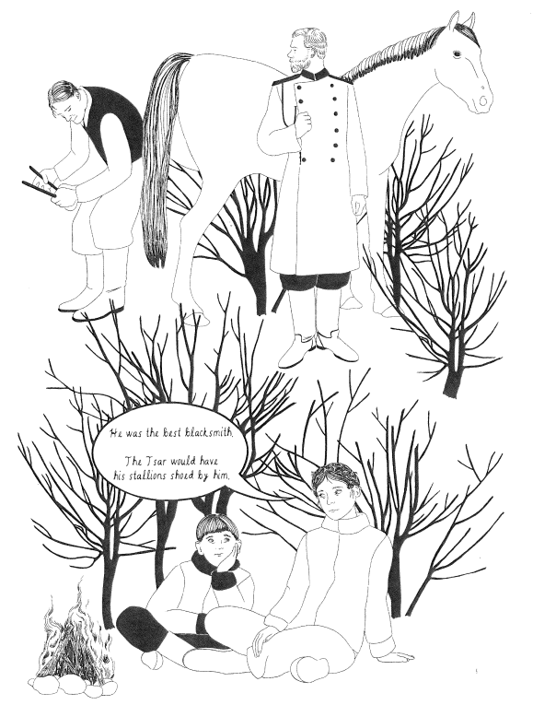
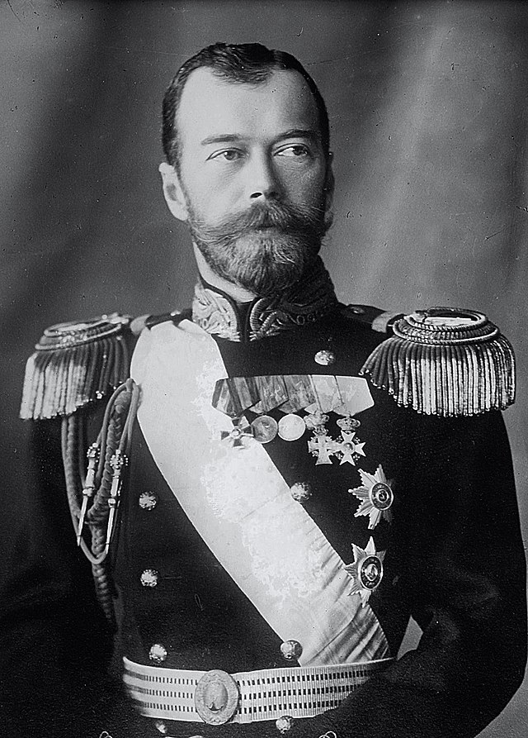
Tsar Nicholas II
Notes:
Page 53: Tato
Tato is the affectionate word for father in Ukrainian, like daddy in English
Page 55 Tsar
Tsar is the term used for the ruler of Russia before the 1917 revolution. The Tsar pictured in the novel is Tsar Nicholas II. He ruled Russia from 1894 until 1917. He was forced to abdicate the throne in 1917. Picture of Tsar Nicholas II, the last tsar of Russia before the revolution.

Slide 13
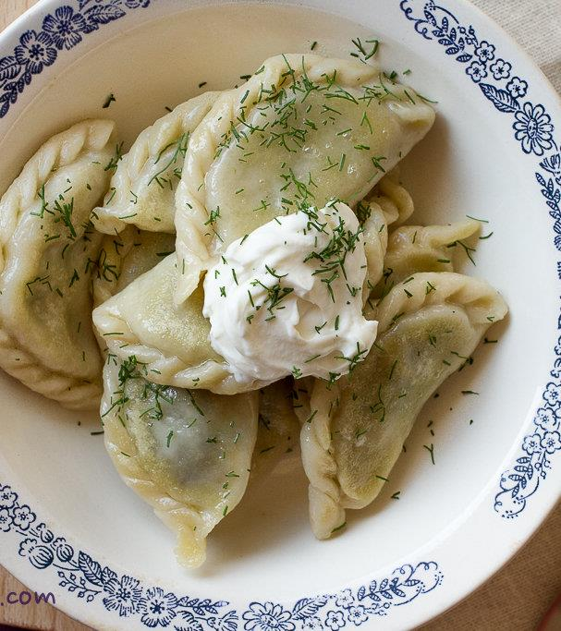
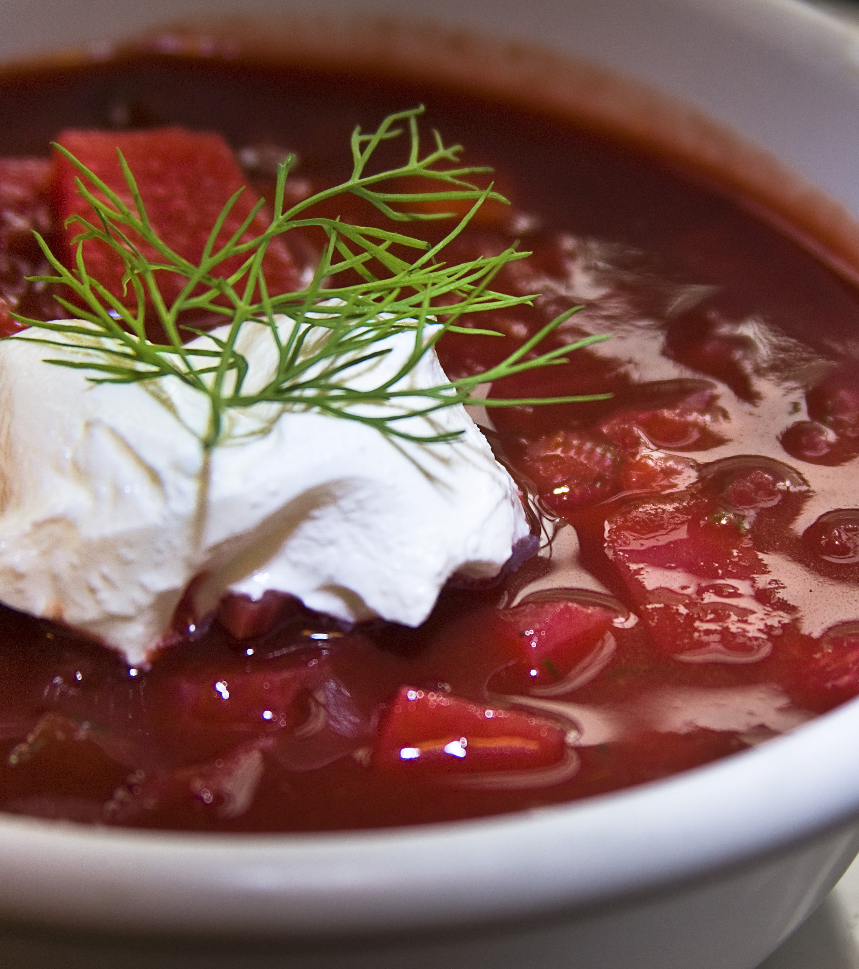
Borscht and varenyky
Notes:
Page 68 borscht and varenyky
Borscht is a traditional soup in Ukraine and Russia. It is made of beets, potatoes, meat, and cabbage. It is eaten hot or cold and with sour cream and dill. Varenyky are dumplings that can have different fillings such as potato or cabbage. The fact that this girl’s mother is making this food while others were starving shows the inequality in food distribution and emphasizes that the Holodomor was a man-made famine. Some people, such as Party officials and their families, had access to food, while others, like the rural population, did not.

Slide 14
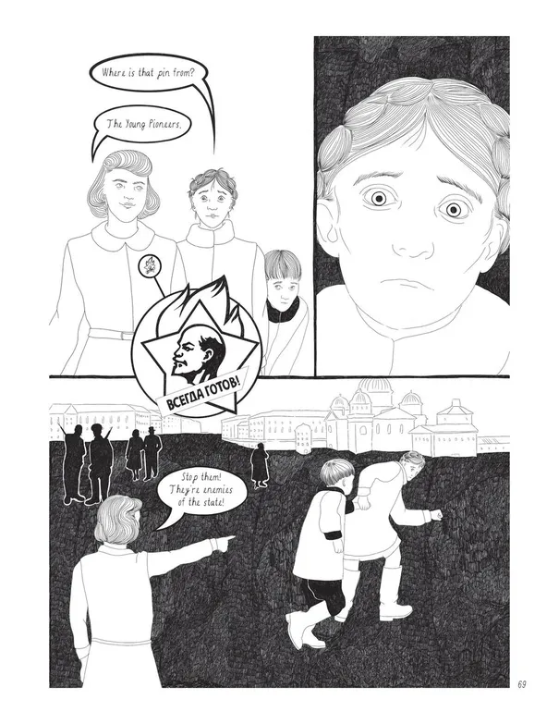
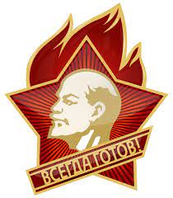
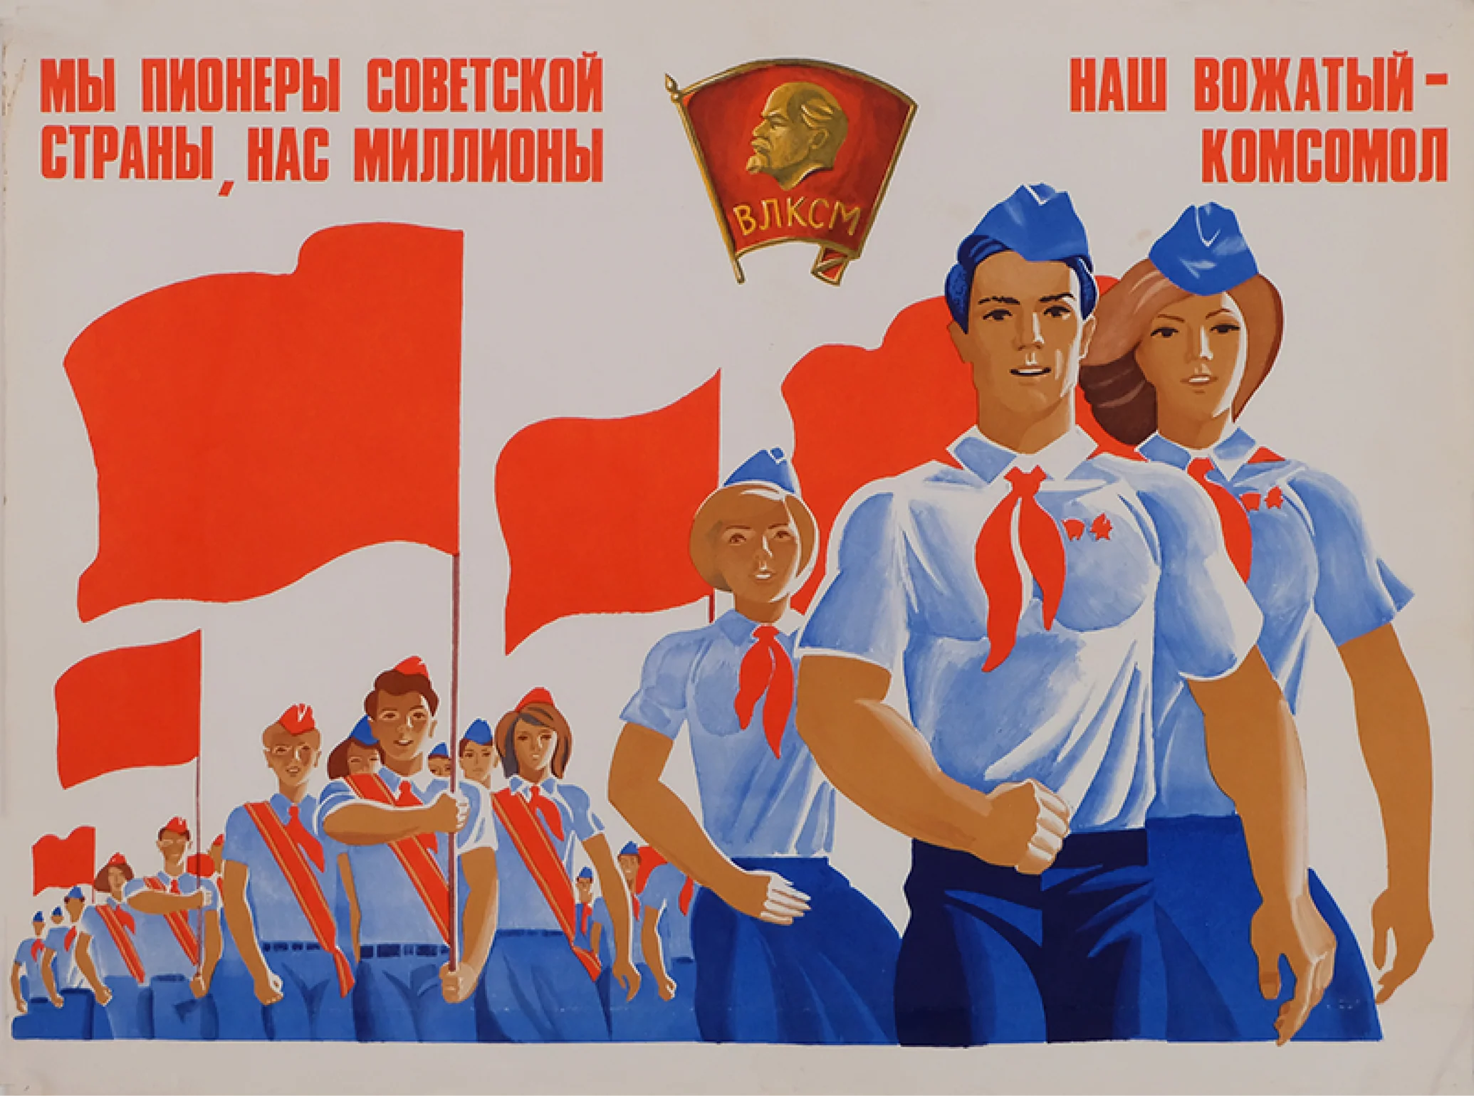
The Young Pioneers
Notes:
Page 69 Pin
The pin that the children see is from the Young Pioneers. It has the profile of Soviet leader Vladimir Ilych Lenin and says всегда готов (pronounced vsegDA guhTOv) and means always ready, like the American Boy Scouts’ slogan “always prepared.”
The propaganda poster to the right says “We are pioneers of the Soviet state, there are millions of us. The Komsomol is our counselor.”
The Young Pioneers was a youth organization in the Soviet Union for kids between 9 and 14. Almost all children belonged to the organization. The fact that Nadia and Taras don’t recognize the pin makes the young pioneer think they are enemies of the state, not good Soviet-minded children. The Young Pioneers started in 1922. Pioneers could be boys or girls. It was a way to indoctrinate youth into the Soviet mindset. They helped promote the communist message. Part of this was atheism, one reason why the organization received pushback in rural areas.
The Komsomol was a Communist youth group. Kids from the Young Pioneers would often join after aging out of the pioneers at 14.
Enemies of the State
Enemy of the state was a phrase often used to denounce people in the Soviet Union. They could be people who politically opposed the Soviet regime, or they could be labeled as such due to their class origins. People related or close to those deemed enemies of the state were seen as suspicious. Most “enemies of the state” were imprisoned, and others were executed

Slide 15
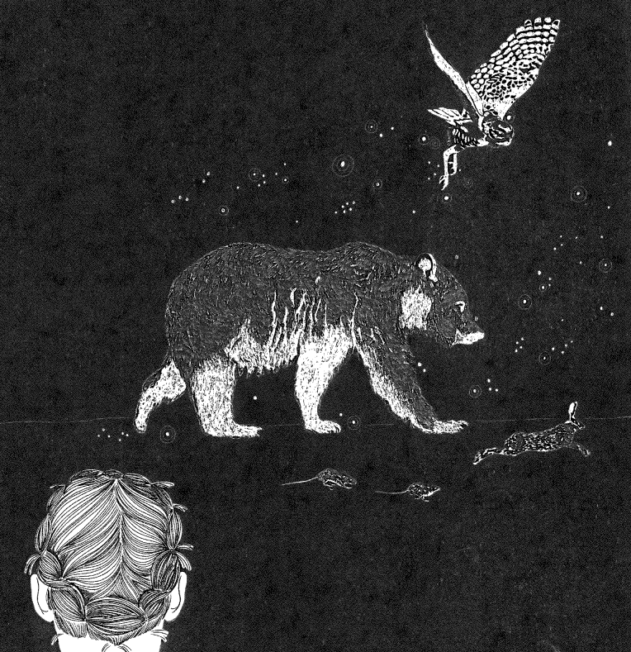
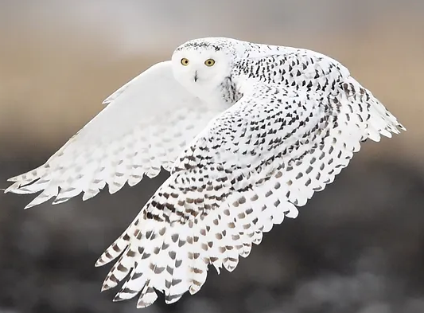
The Owl in
Ukrainian Folklore
Notes:
Page 81 Animals
This page shows Nadia looking at a group of forest creatures including mice, a rabbit, a bear, and an owl. The owl has appeared several times throughout the novel (cover, 26, 27, 49, 78, 81, 82).
In an interview, the illustrator of the novel (Ivanka Galadza) mentioned that at this point in the novel when background switches to black it gives eerie and mystical feeling and indicates that we are in the spiritual realm. She also mentions that birds in the novel represent souls.
In Ukrainian folklore, like in many cultures, the owl is associated with wisdom. They are seen as messengers and advisors in Slavic folklore.
We learn that the owl’s name is Zorka and she led Nadia to the old woman’s house. Zorka is a diminutive of the Slavic name Zora, which means “dawn, aurora, or daybreak.” In Slavic mythology Zorya is a goddess, the female personification of dawn. She is the sister of the sun and moon and opens and closes the gates for the sun each day. Sometimes she is depicted as two sisters. One of her/their jobs is to watch over the doomsday hound that is chained to the Ursa Minor (little bear) constellation. If it gets free the world will end.

Slide 16
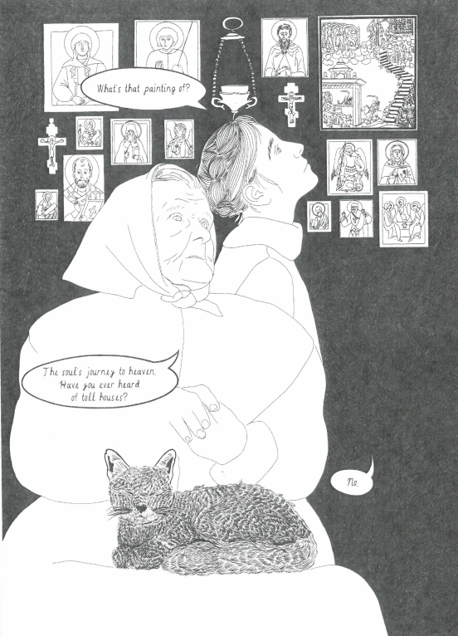
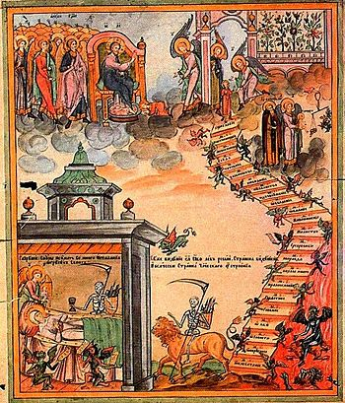
Icons, St. Theodosia, and Toll Houses
Notes:
Page 87-88 Icons, Soul’s journey to heaven, Toll houses
Nadia is looking at the various icons in the old woman’s house and sees one that interests her in particular. She asks what it is and the woman says, the soul’s journey to heaven. She asks Nadia if she has ever heard of toll houses.
In an interview, the novel’s illustrator, Ivanka Galazda, said that this particular icon was her inspiration for an initial sketch she made when she first started working on the novel. It is the 19th century Orthodox icon called the Death of St. Theodosia, which depicts her soul traveling through the afterlife.
The old woman mentions toll houses. Some Orthodox people believe that after a person dies, angels escort their soul to heaven. On this journey, the soul passes through a realm inhabited by evil spirits. The soul encounters these demons, which accuse the soul of sins and try to drag it down to hell. The points of these encounters are called toll houses. There are several toll houses, the number of them is not exact. These are where the soul is tested on its way to heaven. The first toll-house is where the soul is questioned about sins of the tongue (lies/slander). The following toll-houses include things like gluttony and laziness, theft and covetousness, injustice, envy and pride, anger, murder, magic, lust, adultery and sodomy, heresy, and lack of mercy ( source: orthodoxinfo.com/death/theodora.aspx).
The author and illustrator said that the idea of toll-houses is the underlying theme of the novel. Nadia goes on a journey and is tested along the way until her soul, represented as a bird, eventually ascends to heaven. St. Theodosia is the patron saint of the infirm.

Slide 17
Icon-Inspired Graphics
Notes:
Page 92 Nadia’s nightmare
This page depicts a nightmare that Nadia is having. The image has a lot of references to Orthodox icons. The ladders are probably references to the icon Ladder of Divine Ascent and Moral Improvement which depicts the process of ascension of monks from earth to Heaven. The ladder is a symbol of spiritual development in life. The 30 rungs on the ladder correspond to the 30 stages of monks’ ascetic existence. Jesus welcomes those who reach the top. The ladder divides the visual space of the icon into two parts. The top embodies positive virtues. The bottom section depicts hell, full of demons trying to tempt and pull the monks on the ladder down to their level. Those who can’t resist are pulled or fall into the abyss. (Source: Russianicon.com).
There are also visual references to icons that depict hell. According to the Museum of Russian Icons, “Hell is typically displayed in the lower left-hand corner and is represented as an open mouth, with or without teeth, usually with one eye, in a sagittal cross-section. Such representations of Hell are referred to as “Hellmouth” and are meant to represent the whale in the tale of Jonah. The whale expels Jonah from its mouth, and hence the mouth shape.” (Henry A. Hundt and Raoul N. Smith, “A Teratological Source of Hellhead,” museumofrussianicons.org).
Nadia’s mind is processing her fear that, now separated from her, Taras will fall victim

Slide 18
Bribery in the Soviet Union
Russian & Ukrainian Language
Notes:
Page 95 babushka means grandmother in Russian (the Ukrainian is babusya).
Even though they are in Ukraine, many people would speak Russian, including Soviet officials. Ukrainian was spoken in more rural areas while Russian was spoken in urban areas in Ukraine. There was a renewed campaign against the Ukrainian language under Stalin. “The link between language and the countryside also meant that the Ukrainian national movement always had a strong ‘peasant’ flavour” (Anne Applebaum, Red Famine).
Page 96 bribe guard with alcohol
Bribery was common in the Soviet Union. “Bribery was an everyday phenomenon…the bribe represented a particular variety of informal relationship between the Soviet population and representatives of the state” (James Heinzen, ‘The Art of the Bribe: Corruption and Everyday Practice in the Late Stalinist USSR,’ Slavic Review 66.3, page 389). Bribes could be monetary or goods that were in high demand and/or hard to come by such as certain foods, alcohol, cigarettes etc.

Slide 19
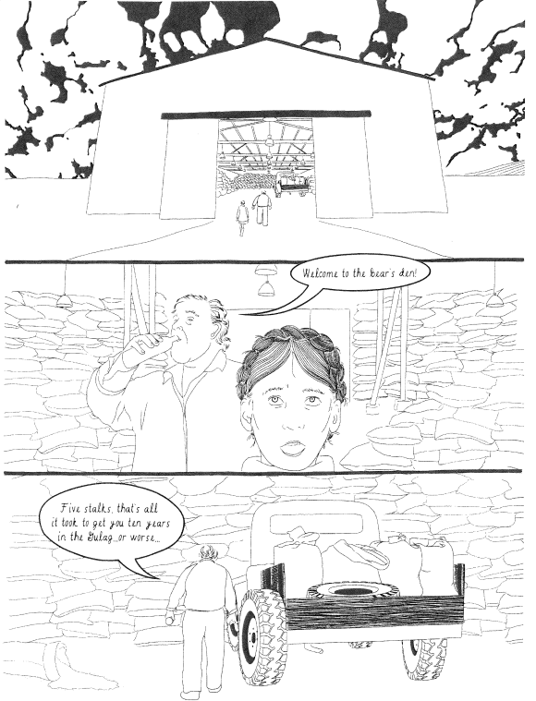
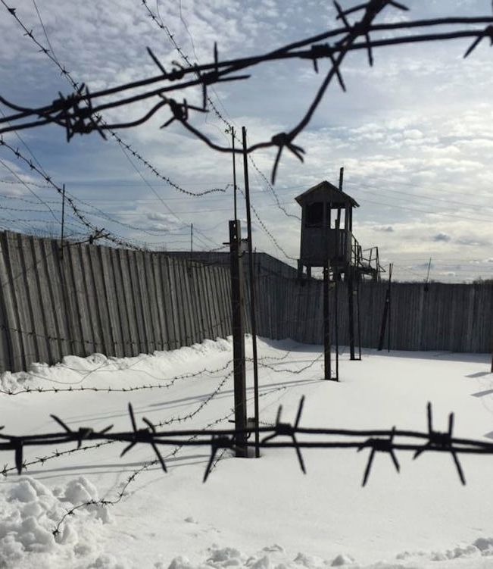
The Gulag
Notes:
Page 99
Five stalks is all it took to get you 10 years in the Gulag or worse. This is referencing the Five Stalks of Grain Policy. In August of 1932, the decree of "Five Stalks of Grain," stated that anyone, even a child, caught taking any produce from a collective field, could be shot or imprisoned for stealing "socialist property." At the beginning of 1933, about 54,645 people were tried and sentenced; of those, 2,000 were executed (University of Minnesota “Holodomor”).
A gulag is a Soviet labor camp. Criminals, either real or falsely accused, were sent there. Many people were political prisoners, or people sent to the camps because they were said to have opposed the Soviet state.
“The word Gulag is actually an acronym (used from 1930) for (Glavnoye Upravleniye LAGerey), or Main Camp Administration, which was a special division of the secret police and the Soviet Ministry of the Interior overseeing the use of the physical labour of prisoners….These political prisoners suffered the most because, on top of the brutal hard labour conditions and the despotism of guards, they were terrorised by criminal prisoners. Historians estimate the total number of Gulag prisoners at 15-18 million, of whom at least 1.5 million did not survive their incarceration” (gulag.online).
For a brief overview of the Gulag visit history.com/topics/european-history/gulag or watch this 3 minute video gulaghistory.org/archive/files/intro_7f39e361eb.mp4

Slide 20
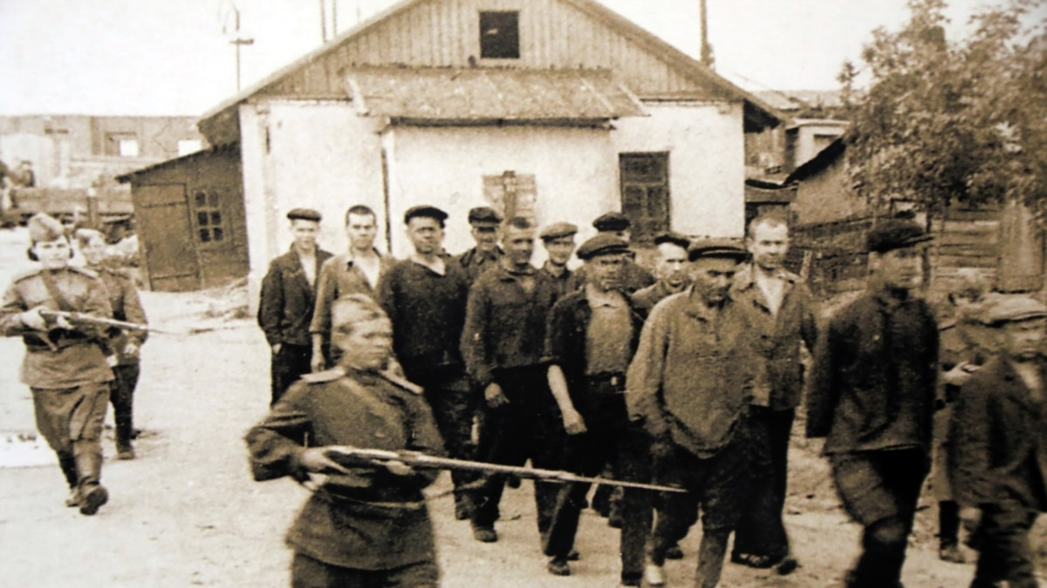
Gulag Prisoners in Perm
Notes:
A photo of Gulag prisoners in Perm (undated). Photo from Radio Free Europe

Slide 21
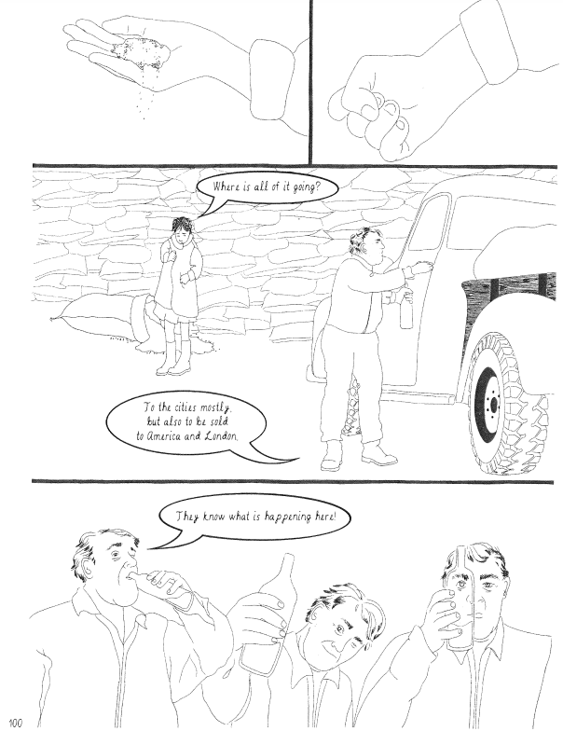
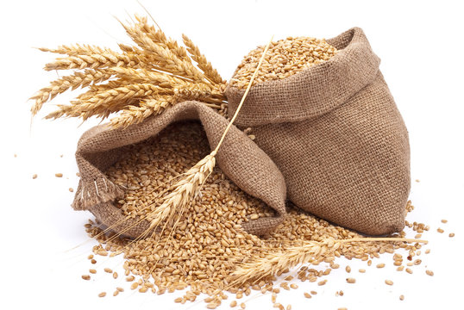
Grain Exportation Abroad
Notes:
Page 100 Grain exportation
When Nadia asks where all the grain is going, the man answers that it is going to the cities and to America and London. During the Holodomor, even though Ukrainians were starving, Soviet authorities took grain from Ukraine and used it to feed the urban populations. It was also exported abroad to help fund industrialization or purchase other foodstuffs. The Soviets extracted 4.27 million tons of grain from Ukraine in 1932, which was enough to feed at least 12 million people for an entire year.

